Slide 1
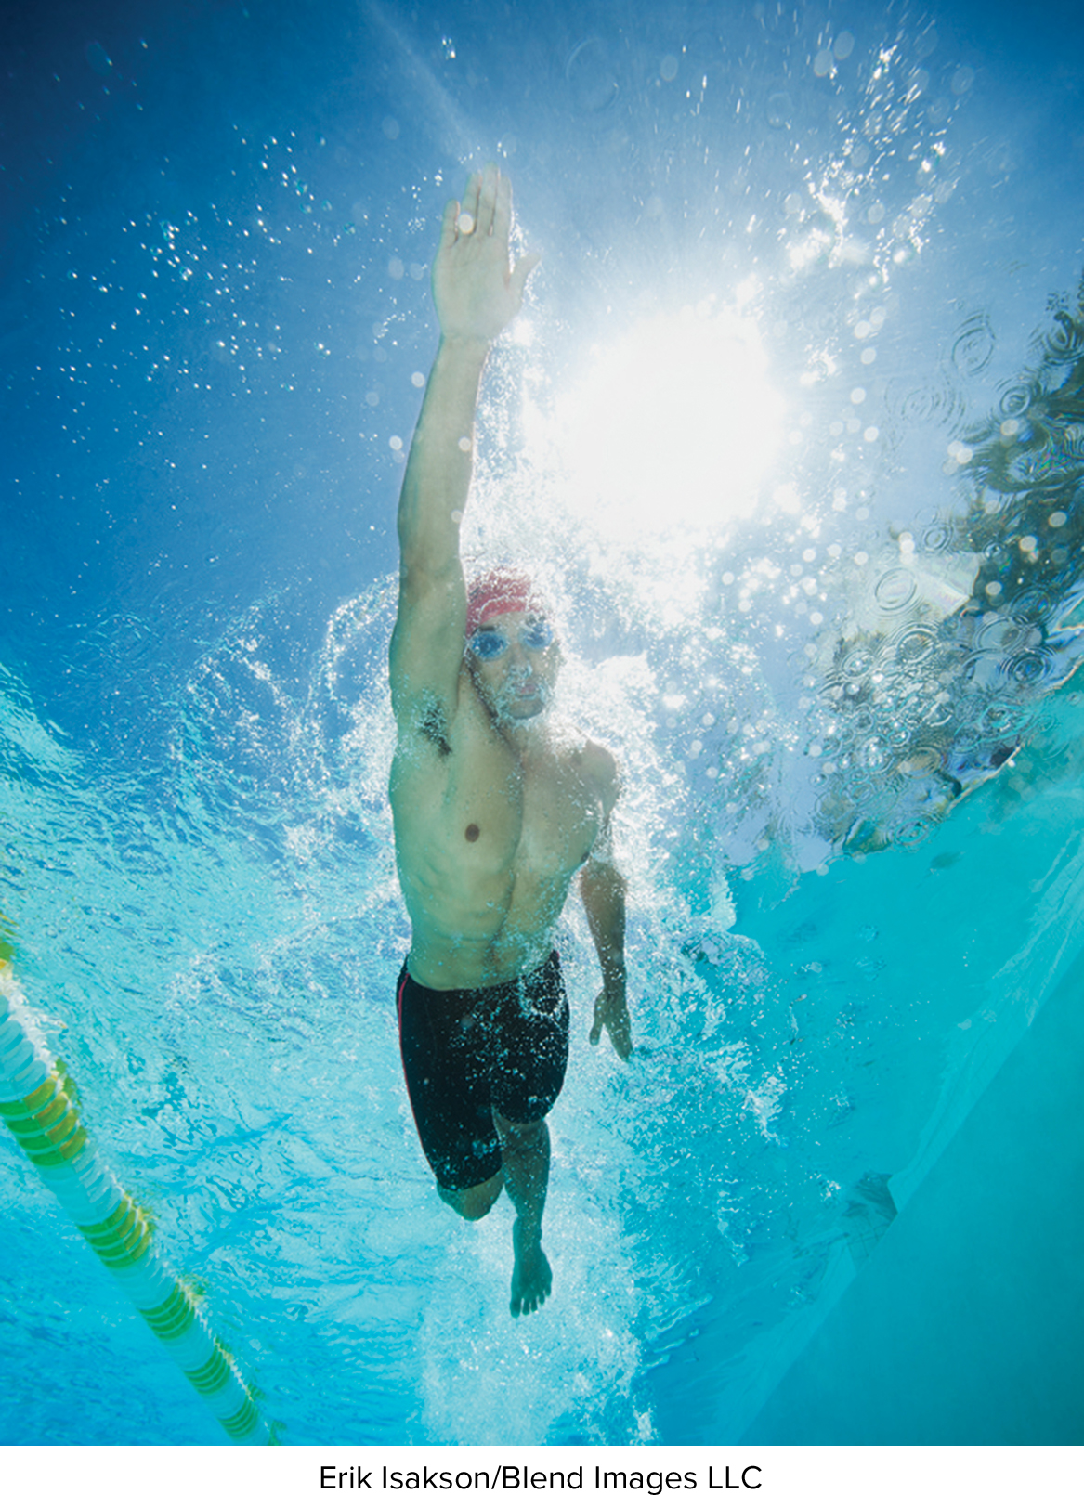
Chapter 10
Nutrition: Fitness and Sports
Wardlaw’s
Contemporary
NUTRITION
Twelfth Edition
© 2022 McGraw Hill, LLC. All rights reserved. Authorized only for instructor use in the classroom.
No reproduction or further distribution permitted without the prior written consent of McGraw Hill, LLC.
Notes:
In this Chapter we will take a look at the big picture of how we use food as fuel for activity.

Slide 2
Student Learning Outcomes 1
List at least five positive health-related outcomes of a physically active lifestyle.
List three key elements of a sound fitness regimen.
Describe the use of carbohydrates, fat, and protein to meet energy needs during various activities.
Differentiate between anaerobic and aerobic uses of glucose and identify advantages and disadvantages of each.
Explain how muscles and related organs adapt to an increase in physical activity.
Notes:
We will talk about the Physical Activity Guidelines and the benefits of physical activity.
We're going to start with a general idea of physical activity and then move towards the really specific athlete-oriented sports nutrition advice.

Slide 3
Student Learning Outcomes 2
Describe how to estimate an athlete’s nutrient needs and discuss the general principles for meeting overall nutrient requirements in the training diet.
Examine problems associated with dehydration and outline the importance of maintaining optimal fluid status during physical activity.
Understand how athletes can optimize performance by consuming foods and fluids before, during, and after exercise.
List several ergogenic aids and describe their effects on an athlete’s performance.
Notes:
We’ll talk about the specific nutrient needs of athletes and what foods they can use to help meet their needs.
Then we'll end up with some stuff about products and ergogenic aids.
Ergogenic means work producing, these will be products or supplements meant to help people enhance their sports performance.

Slide 4
Fake or Fact? 1
The more protein you eat, the more muscle you will gain.
FAKE NEWS
Protein does impact muscle mass. Protein beyond what is required equates to extra calo-ies that most do not need. It is best to time your protein intake in relation to your workouts. For instance, consume ample protein before or immediately after a workout for muscle repair and recovery.
THE FACTS
Notes:
Although protein does impact muscle mass, the fact is that the vast majority of athletes and college students meet their daily protein.
Protein beyond what is required equates to extra calories that most do not need.
It is best to time your protein intake in relation to your workouts.
For instance, consume ample protein before or immediately after a workout for muscle repair and recovery.
Specific protein and nutrient recommendations are discussed in detail in this chapter and vary by age, type of activity, intensity, and other factors.

Slide 5
Section 10.1: An Introduction to Physical Fitness—Concepts
Differentiate between physical activity and exercise.
How much physical activity is recommended by the Physical Activity Guidelines for Americans to reduce risks for chronic diseases?
List five benefits of regular physical activity.

Slide 6
Physical Activity, Exercise, and Physical Fitness
Physical activity, exercise, and physical fitness are not synonymous.
Physical activity:
Any movement of skeletal muscles that requires energy.
  Benefits of physical activity outweigh the risks for most Americans.
Exercise:
Physical activities that are planned, repetitive, and intended to improve physical fitness.
Notes:
These are some of the terms in this chapter.
Physical activity is any movement that requires energy.
Exercise is physical activity that is planned and meant to increase fitness.
Physical fitness is the ability to perform a moderate-to-vigorous activity without getting excessively tired.

Slide 7
Types of Activities
Moderate-intensity:
  Aerobic activity that increases heart rate and breathing.
  Brisk walking, dancing, swimming, bicycling (level terrain).
Vigorous-intensity:
  Aerobic activity that greatly increases heart rate and breathing.
  Jogging, tennis, swimming (continuous laps), bicycling uphill.
Muscle-strengthening:
  Activity that increases skeletal muscle strength, power, endurance, and mass.
  Strength training, resistance training, muscle strength, and endurance exercises.
Notes:
Then we have different levels of physical activity.
When you look at the Physical Activity Guidelines, you will see the terms moderate-intensity and vigorous-intensity.
The main difference is whether you can talk to somebody when you're doing this exercise.
If you can talk to somebody while you're working out, that's moderate.
If you are huffing and puffing, that's vigorous.
Vigorous is greatly increasing your heart rate and breathing.
Then there's also muscle-strengthening activity, which is an important aspect of a fitness program.
It’s going to increase muscle strength, power, and endurance.

Slide 8
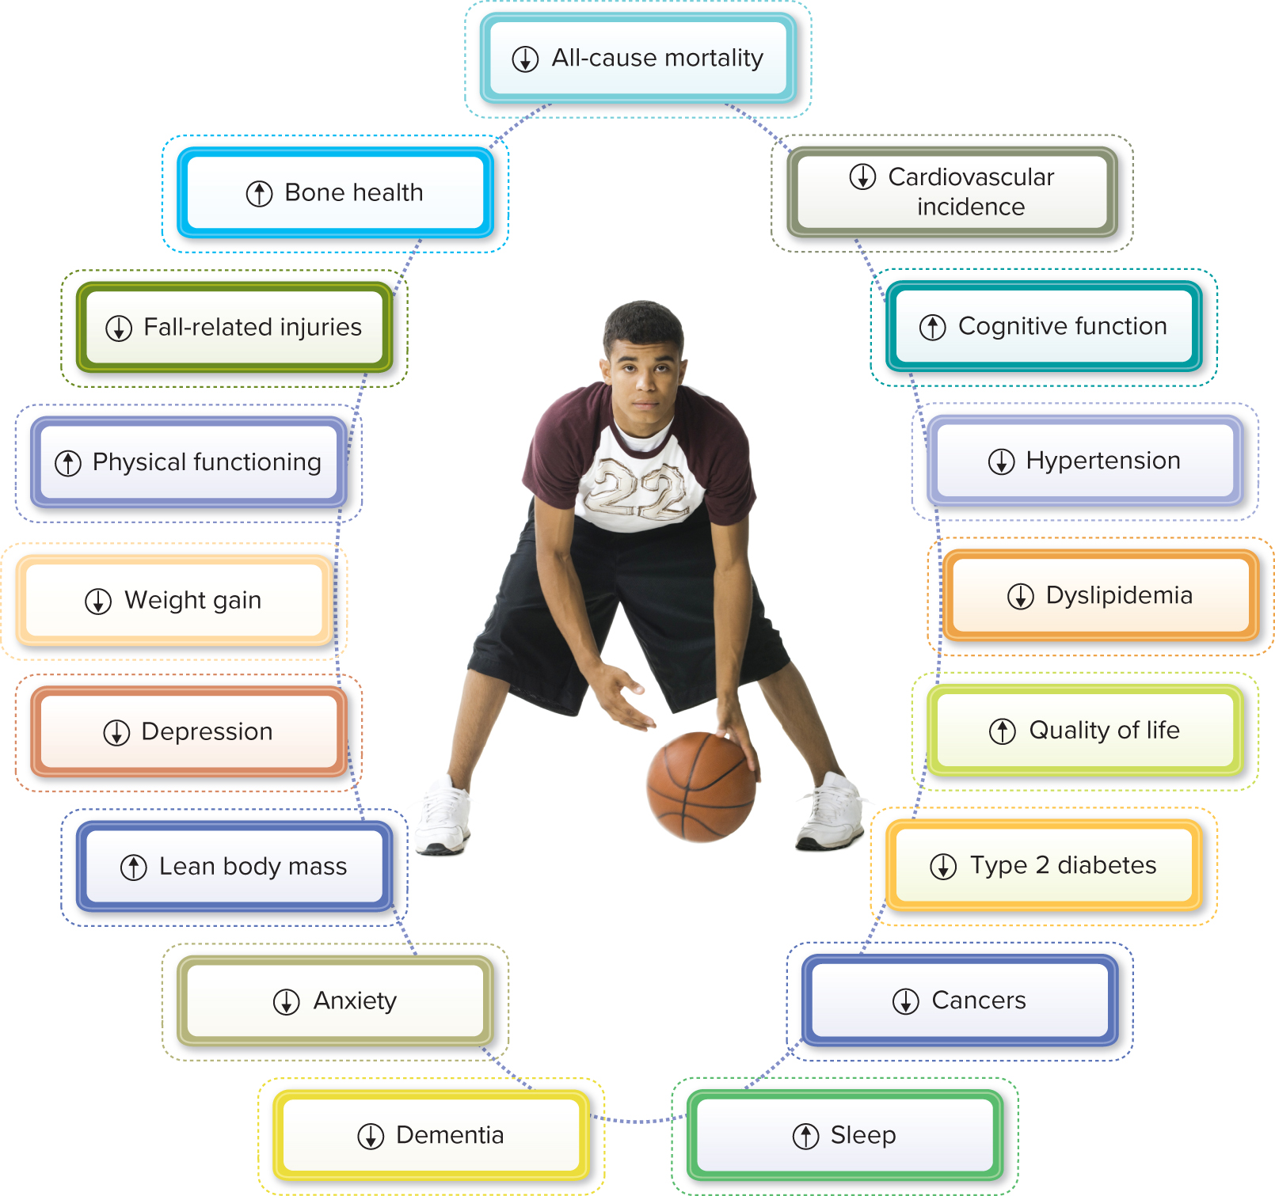
Figure 10-1: Benefits of Physical Activity
Rubberball/Getty Images
Access the text alternative for slide images
Notes:
Figure 10-1 is a diagram of the benefits of physical activity.
We don't need to dwell on these because they're very intuitive.
Basically it's going to benefit everything.
It helps reduce chronic disease risk, it helps with body composition, and it helps your brain.
From head-to-toe, there are benefits of physical activity.
Look at the points in this chart and make sure you know those.

Slide 9
2018 Physical Activity Guidelines for Americans 1
For substantial health benefits, adults should do one of the following:
At least 150 to 300 minutes per week of moderate intensity aerobic physical activity OR
75 to 150 minutes per week of vigorous-intensity aerobic physical activity. OR
An equivalent combination of moderate- and vigorous-intensity aerobic activity.
Spread aerobic activity throughout the week.
Move more and sit less
Notes:
The U.S. Department of Health and Human Services’ (DHHS) Physical Activity Guidelines for Americans recommends that all individuals avoid inactivity.
Any physical activity is better than none, and people who participate in even small amounts of physical activity gain health benefits.
The Physical Activity Guidelines were recently updated.
In 2008, the Physical Activity Guidelines first came out and in 2018, they got a little facelift.
The key physical activity recommendations include the following:
One-hundred-fifty to 300 minutes per week of moderate-intensity physical activity is needed for adults.
For kids, it's going to be a little bit higher.
Seventy-five to 150 minutes per week of vigorous-intensity physical activity is recommended.
So, it's either/or. If you're just doing moderate activity, then you need to spend a little bit more time being active.
If your activity is vigorous, you can get away with less time and still keep your risk for chronic diseases low.
Or, you could do some combination of vigorous and moderate.
One of the biggest differences is that the old Physical Activity Guidelines said 150 minutes per week is what we need to prevent chronic diseases. The new one says 150 to 300 minutes per week. It’s a little bit more.

Slide 10
2018 Physical Activity Guidelines for Americans 2
For additional and more extensive health benefits, adults should do one of the following:
Increase physical activity beyond 300 minutes per week of moderate-intensity OR
150 minutes per week of vigorous-intensity aerobic physical activity OR
An equivalent combination of moderate- and vigorous-intensity activity.
Adults should also include muscle-strengthening activities that involve all major muscle groups on 2 or more days a week.
80% of American adults fail to achieve levels of physical activity set forth in Physical Activity Guidelines.
Notes:
However, if you want to lose weight and keep it off, it's going to take more than 150 minutes per week.
For additional health benefits, more than 150 minutes, four days per week is better. Muscle-strengthening on two or more days per week is recommended.
This was mentioned in the 2008 Guidelines, but now it's more emphasized.
If we can keep our lean mass in good shape as we age, that's going to help to fight that decline in BMR as we age.
That will help us to burn more calories every day.
It also gives different advice for different age groups.
Complying with the Physical Activity Guidelines is the first step toward managing weight, reducing risks for chronic diseases, and improving physical fitness.
Unfortunately, many adults in the U.S. lead sedentary lifestyles.
Only about 20% of American adults consistently achieve the level of physical activity set forth by the Physical Activity Guidelines.

Slide 11
Section 10.2: Achieving and Maintaining Physical Fitness—Concepts
Why is goal setting important for the success of a physical activity program?
Differentiate between muscular strength, muscular endurance, and muscular power.
List two evidence-supported benefits of flexibility exercises.
Provide three tips for a person who needs help with maintaining a fitness program.

Slide 12
Assess Your Current Level of Fitness
Start by assessing your current level of fitness.
Men over 40 and women over 50, discuss fitness goals with primary care provider.
Fitness professional can help with a safe start and realistic goals.
  Health problems requiring medical evaluation include:
  Obesity
  CVD
  Hypertension
  Diabetes
  Chest pains
  Arthritis
Notes:
Start by assessing your current level of fitness.
In some cases, it is beneficial to seek medical advice before getting started.
Men age 40 years or older and women age 50 years or older, anyone who has been inactive for many years, or those who have an existing health problem should discuss their fitness goals with their primary care provider before altering physical activity pat-terns.
Health concerns that may require medical evaluation before beginning a fitness program are listed here.

Slide 13
Set Your Goal
Goal setting will enhance your success.
Sports dietitians:
Trained professionals who can help you set reasonable physical activity goals based on your current level of fitness.
Board Certification as a Specialist in Sports Dietetics (CSSD) credential is the premier professional sports nutrition credential in the U.S.
Wearable fitness devices:
Pedometers and smartphone app accelerometers.
Help motivate you on your quest to become more physically active.
Notes:
Sports dietitians are trained professionals who can help you set reasonable physical activity goals based on your current level of fitness.
A Board Certification as a Specialist in Sports Dietetics (CSSD) credential is the premier professional sports nutrition credential in the U.S.
Board Certified Specialists in Sports Dietetics (CSSD) CSSDs are registered dietitian nutritionists (RDNs) who provide safe, effective, evidence-based nutrition services for health, fitness, and athletic performance.
Wearable fitness devices to measure physical movement are now more accurate and less expensive than ever.
These can help motivate you on your quest to become more physically active.
Devices include pedometers that count steps and accelerometers that measure trunk or limb movement.
Smartphone app accelerometers, such as wrist watches, have become the norm. Many of these devices use multi-sensor systems that measure steps, often paired with global positioning systems (GPS) that provide estimates of speed and distance.
Many now include heart rate monitors and track intensity of movements.

Slide 14
Plan Your Program
A balanced fitness program will include various types of activities:
Aerobic, muscle- and bone-strengthening, flexibility.
Use FITT principle:
  Frequency—Number of days per week
  Intensity—How hard you work, heart rate, and resistance
  Time—How long is each session
  Type of exercise—Choice of exercise
Notes:
Although your goal may focus on just one aspect of fitness, such as being able to bench-press your body weight, a balanced fitness program will include various types of activities, such as aerobics, muscle- and bone-strengthening, balance training, flexibility, and more.
Use the FITT principle explained here.

Slide 15
Table 10-1: Elements of a Well-Rounded Fitness Program
 | Aerobic Fitness | Muscular Fitness | Flexibility
Frequency | 3 to 5 days per week | 2 to 3 days per week | 2 to 3 days per week
Intensity | 60% to 85% of MHRª or RPE^{b} of 4 or higher | 70% to 80% of 1 RM^{c} (lower for endurance and higher for strength) | To the point of tension
Time | 150 minutes per week | 2 to 3 sets of 8 to 12 repetitions or 1 set of 8 to 12 repetitions to fatigue. | 2 to 4 repetitions of 8 to 12 different exercises, held for 10 to 30 seconds each
Type (examples) | Brisk walking, running, cycling, swimming, basketball, tennis, and soccer | Bench press, squat, biceps curl, and abdominal crunch | Hamstring stretch, shoulder reach, and side bend
ª Maximal heart rate; ^{b} Rating of perceived exertion; ^{c} 1-repetition maximum.
Notes:
Table 10-1 summarizes the American College of Sports Medicine (ACSM) recommendations for planning a general fitness program.

Slide 16
Aerobic Exercise Enhances Cardiovascular Endurance
Aerobic: “with oxygen.”
Use large muscle groups with aim to increase heart rate.
Ways to determine intensity:
  Percentage of age-predicted maximum heart rate (MHR).
  Rating of Perceived Exertion (RPE) scale.
Components of aerobic activity:
  Intensity, or how hard a person works to complete the activity (usually described as moderate or vigorous).
  Frequency, or how often a person engages in aerobic activity.
  Duration, or how long a person engages in the activity for one session.
Notes:
Remember aerobic means “with oxygen.”
Aerobic activity is intense enough and long enough to maintain or improve your cardio-respiratory fitness.
Listed here are the three components of aerobic activity:
Intensity or how hard a person works to complete the activity (usually described as moderate or vigorous). Ways to determine intensity, MHR and RPE are listed here.
frequency or how often a person engages in aerobic activity; and
duration or how long a person engages in the activity for one session.
The ability to perform aerobic activity depends on the health of your heart and lungs—the organ systems that provide oxygen to the cells of the body.
Aerobic activities usually form the backbone of a fitness program.
Indeed, many of the benefits of fitness are direct effects of aerobic training.

Slide 17
Determining Exercise Intensity
Age-predicted maximum heart rate (MHR):
MHR = 220 − age
  Initial program:
    50% to 65% of MHR
  Intermediate:
    60% to 75% of MHR
  Experienced:
    70% to 85% of MHR
For example: for 20-year-old
    220 − 20 = 200 MHR
    Initial program:
    50% to 65% of MHR
  200 × 0.5 and 200 × 0.65 = 100 to 130 beats per minute
Notes:
Measuring Your Heart Rate
Most wearable fitness trackers now contain automatic heart rate monitors.
If you do not own one, you can manually check your heart rate by following the following steps shown here.
1. Stop and count your heartbeats for 10 seconds.
2. Multiply that number by 6 to determine your heartbeats per minute.

Slide 18
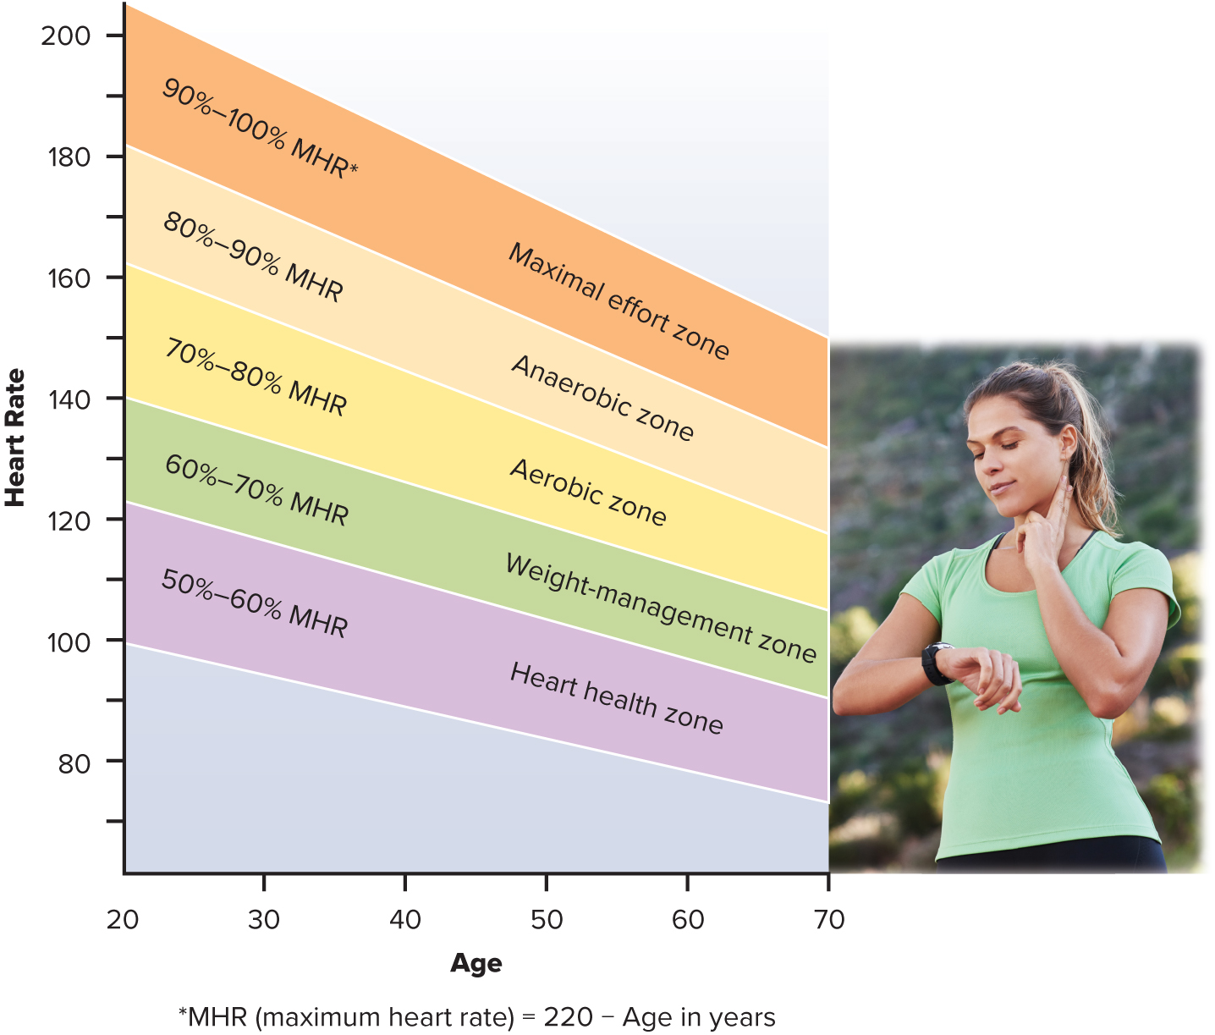
Figure 10-2: Heart Rate Training Chart
This chart shows the number of heartbeats per minute that corresponds to various exercise intensities.
PeopleImages/Getty Images
Access the text alternative for slide images
Notes:
FIGURE 10-2 is a chart for heart rate training. This chart shows the number of heartbeats per minute that corresponds to various exercise intensities.
To Calculate Your Target Heart Rate
1. Determine your age-predicted maximum heart rate, MHR, using Fig. 10-2, but subtracting your age from 220:
For a 20-year-old person, MHR equals 200 beats per minute (220 − 20 (age) = 200 beats per minute (bpm).
2. At the initiation of an aerobic exercise program, aim for about 50% to 70% of MHR as a target heart rate (THR):
200 bpm × 0.5 (50%) = 100 bmp
200 bpm MHR × 0.7 (70%) = 140 bpm
As you progress and become more physically fit, you can work up to a higher THR. For inter-mediate exercisers, 60% to 75% of MHR is recommended. For trained exercisers, 70% to 85% MHR is suitable.

Slide 19
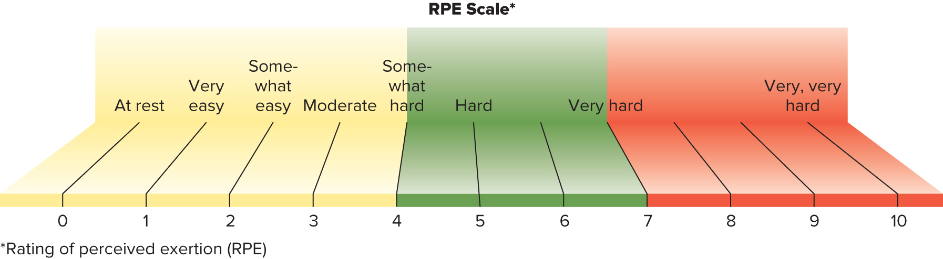
Figure 10-3: Rating of Perceived Exertion Scale
* A Rating of Perceived Exertion (RPE) beyond 10 is considered maximal.
Range of 1 to 10
Each number corresponds to a subjective feeling of exertion.
  From 0 = nothing at all to 10 = close to maximal.
  Aim for number 4, a point at which you begin to see significant results, building/maintaining aerobic fitness.
  Should be working hard, still able to talk to exercise partner (talk test).
Access the text alternative for slide images
Notes:
FIGURE 10-3 diagrams the Rating of Perceived Exertion Scale.
When engaging in physical activity, a rating of a 5 or 6 produces noticeable increases in breathing rate and heart rate.
A level of 7 or 8 produces large increases in a person’s breathing and heart rate.

Slide 20
Musculoskeletal Fitness
Muscular Fitness Encompasses:
Muscular strength:
  Maximal force a muscle can exert against a load at one time.
Muscular endurance:
  Ability of the muscle to perform repeated, submaximal contractions over time without becoming fatigued.
Muscular power:
  Combines strength with speed for explosive movements such as jumping or throwing.
  Include muscle strengthening in your program 2 to 3 nonconsecutive days per week.
Notes:
Muscular strength refers to the maximal force a muscle can exert against a load at one time.
Muscular endurance refers to the ability of the muscle to perform repeated, sub-maximal contractions over time without becoming fatigued. An athlete training for muscular endurance may bench-press 80 to 100 pounds for several sets of 8 to 12 repetitions.
Both muscular strength and endurance are important aspects of muscular fitness that relate to health for athletes of all levels.
Muscular power combines strength with speed for explosive movements such as jumping or throwing.
Power is a crucial aspect of muscular fitness for many athletes.
The Physical Activity Guidelines recommend including muscle-strengthening activi-ties in your fitness program on at least 2 to 3 nonconsecutive days per week

Slide 21
Flexibility Exercises
Flexibility declines with age.
Flexibility exercises enhance balance and stability:
Ability to move a joint through full range of motion.
Improves balance and stability.
Reduces risks of falls and injuries, especially among older adults.
Notes:
Flexibility is an often overlooked aspect of physical health and tends to decline with age.
Flexibility, often called stretching, refers to the ability to move a joint through its full range of motion.

Slide 22
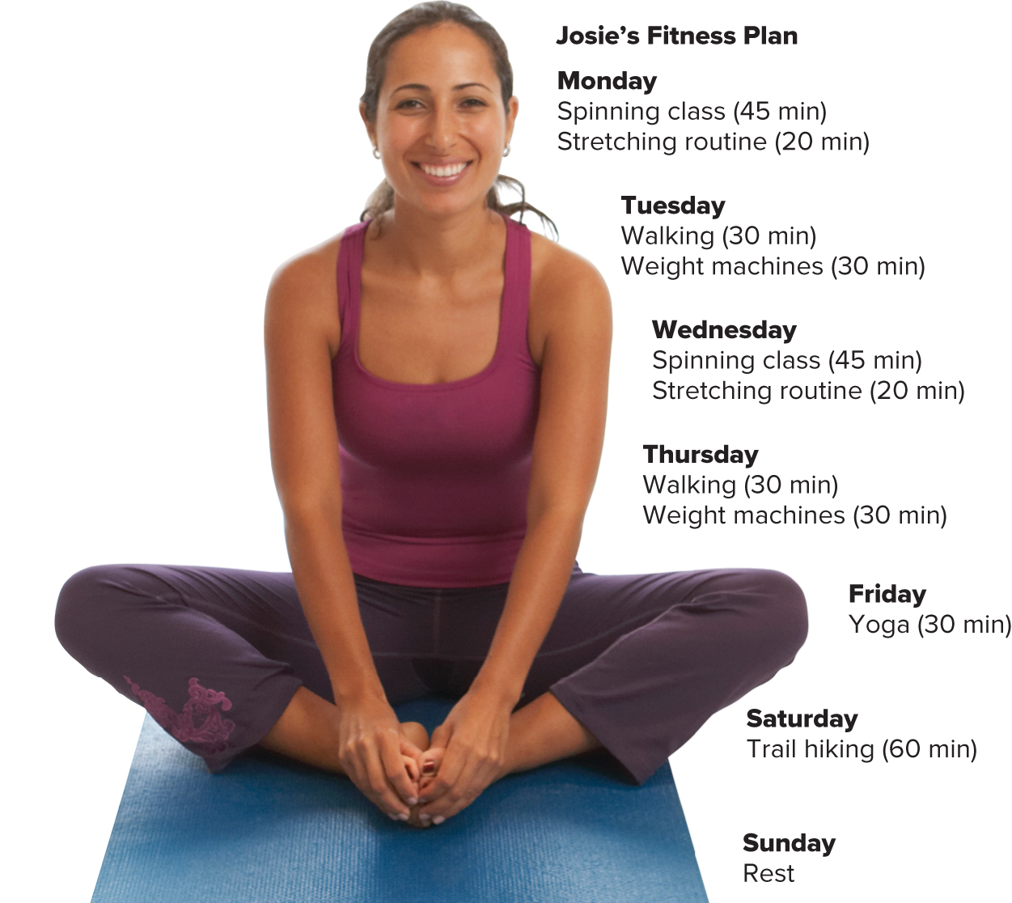
Figure 10-4: Sample Fitness Plan
Josie’s fitness plan incorporates aerobic, strength, and flexibility exercises.
John Lund/Sam Diephuis/Blend Images LLC
Access the text alternative for slide images
Notes:
FIGURE 10-4 shows a sample fitness plan.
This fitness plan incorporates aerobic, strength, and flexibility exercises.

Slide 23
Warm-Up and Cool-Down
Plan for warm-up and cool-down periods as part of your exercise routine.
Warm-up:
  Begin with 5 to 10 minutes of low-intensity walking, slow jogging.
  Increases range of motion and decreases the risk of injury.
Cool-down:
  5 to 10 minutes low-intensity activity.
  Then 5 to 10 minutes stretching.
  Reduces dizziness or light-headedness.
Notes:
It is important to plan for adequate warm-up and cool-down periods as part of your physical activity routine.
Begin by warming up with low-intensity exercises, such as walking, slow jogging, or any low-intensity performance of the anticipated activity.
During cool-down, slow down to low-intensity activity followed by stretching.
It is appropriate to do the same physical activities performed during warm-up.
Although the cool-down does not actually prevent muscle soreness, it does reduce the dizziness or light-headedness that can occur with an abrupt end to a vigorous workout.

Slide 24

Stick With It!
Reward yourself when achieving goals.
Forget occasional setbacks; focus on the long-term benefits to your health.
Maintaining a physical activity program is the hardest part!
To stick with a fitness program, experts recommend to:
Start slowly.
Vary your activities.
Include friends and family members.
Frequently revisit both short- and long-term goals.
Set aside a specific time each day for movement.
Ariel Skelley/Getty Images
Notes:
Even after all the effort of assessing baseline fitness, setting goals, designing a program, and getting started, it turns out that maintaining a physical activity program may be the hardest part!
To stick with a fitness program, follow the recommendations listed here.

Slide 25
Section 10.3: Energy Sources for Active Muscles—Concepts
Describe a process used to resupply ATP during a short, intense burst of activity, such as a 100-meter running sprint.
How does the ATP yield of anaerobic breakdown of glucose compare to that of aerobic breakdown of glucose?
Why is fat a useful source of energy during exercise? Name three types of activity during which fat supplies 50% or more of fuel.
Is protein a useful source of energy during exercise? Why or why not?

Slide 26
Energy Sources for Active Muscles
Body converts food energy to adenosine triphosphate (ATP).
  Main energy currency for cells.
  Chemical energy, high energy bonds.
  Used by cells for muscle contractions, ion pumping, and enzyme activity.
  Only small amount is stored in resting cells.
        2 to 4 seconds worth of work.
Notes:
The energy currency of the cells is adenosine triphosphate (ATP).
Chemical energy is stored in the bonds that hold the carbons, oxygens, and hydrogens together in the macronutrients: carbohydrates, fats, and proteins in foods you eat.
Our cells must break down the bonds in these compounds, which releases chemical energy, and then we use that chemical energy to make ATP.
Cells can then use ATP to power cellular activities.
Carbohydrates, fats, and proteins have valuable energy, but it is not usable by human cells until it is converted to ATP – the energy currency of our cells.
Only a small amount is stored as ATP.

Slide 27
Anaerobic Metabolism
Supplies energy for short bursts of intense activity.
Stored ATP:
Cells must constantly and repeatedly use and then reform ATP, using a variety of energy sources.
Phosphocreatine (PCr):
Used to resupply ATP.
Anaerobic glucose breakdown:
During intense physical activity such as sprinting.
When oxygen supply to muscles is limited.
Notes:
Energy can be supplied through anaerobically, without use of oxygen.
First is the stored ATP.
As soon as ATP stored in muscle cells begins to be used, another high-energy compound, phosphocreatine (PCr), is used to resupply ATP.
Finally glucose can been broken down anaerobically to generate a small amount of ATP.

Slide 28
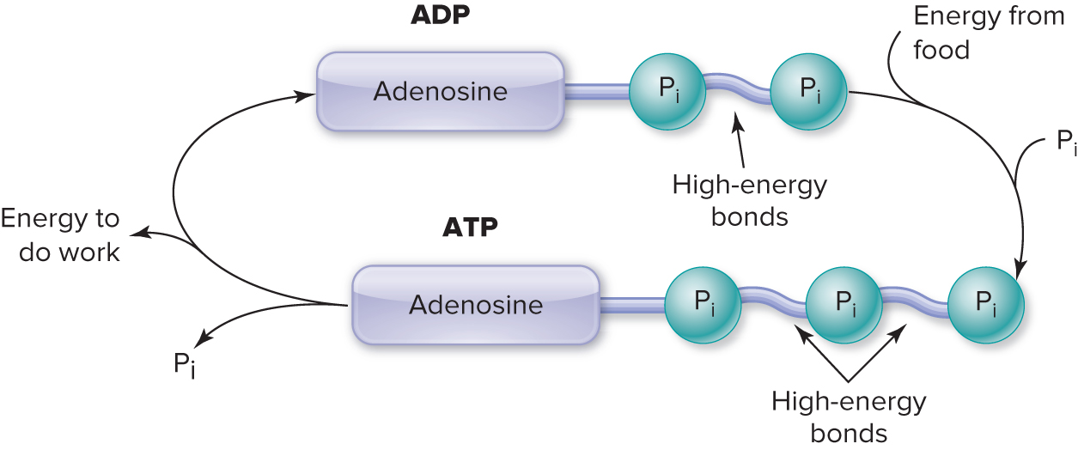
Figure 10-5: Food Energy Is Stored in ATP
Cells convert food energy (from carbohydrates, fat, protein, or alcohol) to adenosine triphosphate (ATP).
Energy stored in chemical bonds between phosphate molecules.
Breakdown of phosphate bonds releases energy to perform cell functions.
Product of the breakdown of ATP is adenosine diphosphate (ADP).
Access the text alternative for slide images
Notes:
A diagram of adenosine triphosphate is shown here on this slide. We can see that there are three phosphates at one end of this molecule. The bonds between the phosphate molecules are high-energy bonds. When we break down the chemical structures of carbs, fats, or proteins to release chemical energy, that chemical energy can be stored in these high-energy bonds between the phosphate molecules of ATP. Then, when our cells break off a phosphate from ATP, we can use that chemical energy to do work, like muscle contraction or pumping ions across cell membranes.
When our cells break off a phosphate group from ATP, what is left is a molecule called adenosine diphosphate (ADP). All the time, our cells are constantly breaking down ATP to ADP to release chemical energy, then they use food energy to rebuild ATP from ADP.
Most of the time, there is a small amount of ATP in our cells, ready to yield energy for cellular tasks, like muscle contraction during physical activity. ATP is an immediate source of energy, but it doesn’t last very long – only a few seconds. Once the ATP is broken down to ADP, we need a way to regenerate ATP if we want to continue to function.

Slide 29
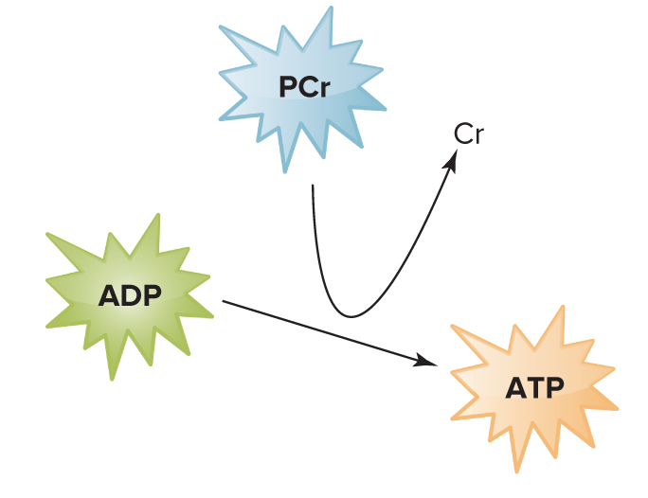
Figure 10-6: Phosphocreatine (PCr)
High-energy compound.
Used primarily during bursts of activity, such as lifting and jumping.
  Can sustain muscle contraction for about 15 seconds.
  Not much PCr made or stored in muscles.
  Creatine supplements sometimes used by strength-training athletes to increase PCr in muscles.
  Enzymes split PCr into phosphate and creatine.
  Releases energy to re-form ATP.
Notes:
When ATP stored in muscle cells begins to be used, another high-energy compound, phosphocreatine (PCr), is used to resupply ATP.
An enzyme in the muscle cell is activated to split PCr into phosphate and creatine.
This releases energy that can be used to reform ATP from its breakdown products.
If no other source of energy for ATP resupply were available, PCr could probably maintain maximal muscle contractions for about 15 seconds.
The main advantage of PCr is that it can be activated instantly and can replenish ATP at rates fast enough to meet the energy demands of the fastest and most powerful actions, including jumping, lifting, throwing, and sprinting.
The disadvantage of PCr is that not much of it is made and stored in the muscles. Strength-training athletes some-times use creatine supplements in an effort to increase PCr in muscles.

Slide 30
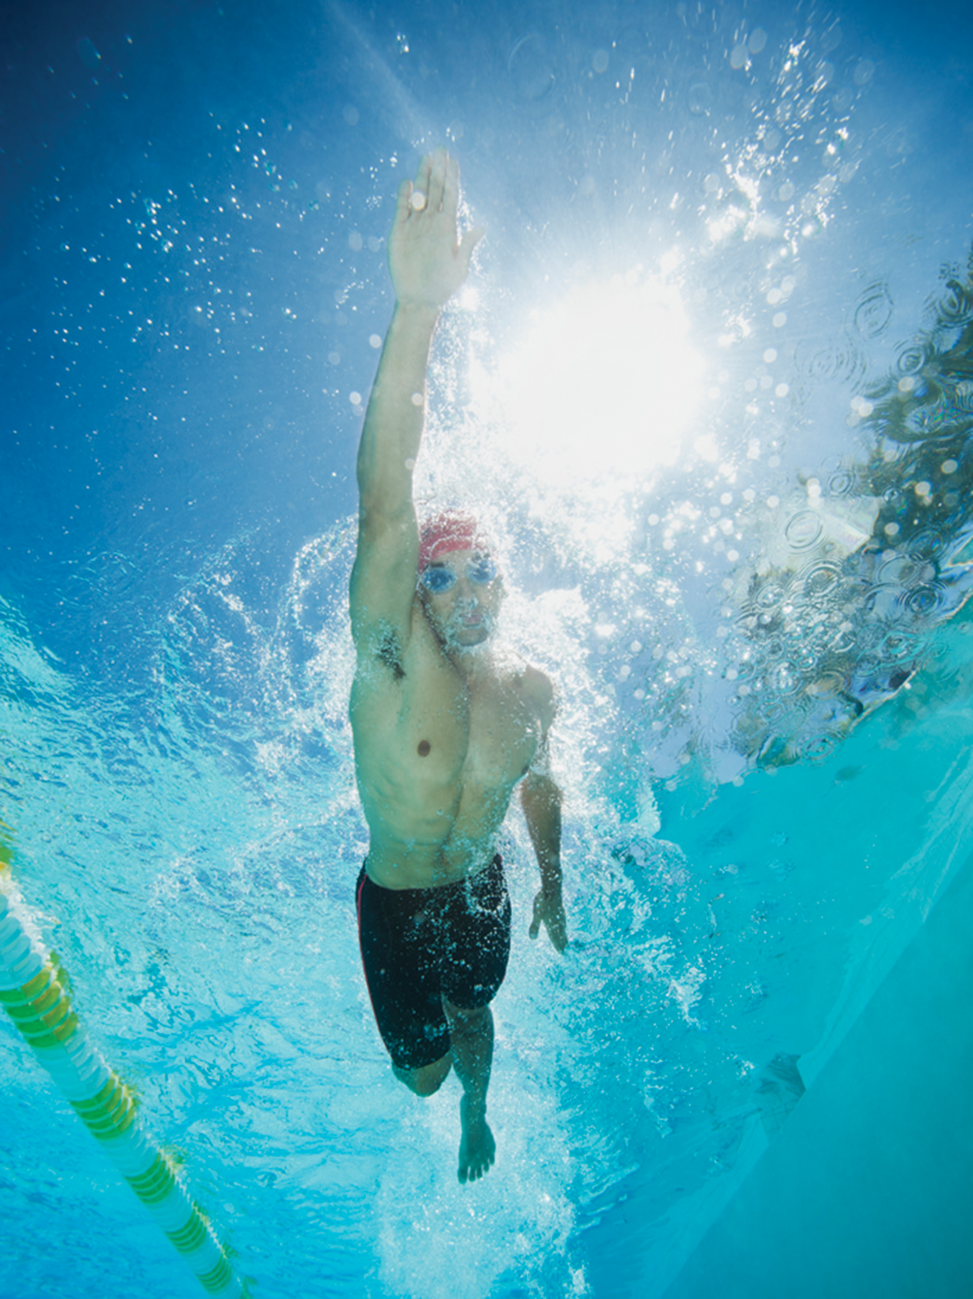
Anaerobic Glucose Breakdown
During intense physical activity such as sprinting
  Limited oxygen; 30 seconds to 2 minutes of work.
Glucose is broken down into 3-carbon compound—pyruvic acid.
  Pyruvic acid is converted to lactic acid.
  Lactic acid buildup causes acidity that inhibits enzymes in muscle.
  Replenishes ATP quickly.
    Produces 2 ATP per glucose, about 5% of energy potential. Cannot sustain ATP production.
Erik Isakson/Blend Images LLC
Bursts of muscle activity, such as swimming 100-meter freestyle, use a variety of energy sources, including ATP, PCr, and glucose.
Notes:
The most useful form of carbohydrate fuel is the simple sugar glucose.
It is available to all cells from the bloodstream.
Glucose is also stored as glycogen in the liver and muscle cells.
Blood glucose is maintained by the breakdown of liver glycogen.
Breakdown of glycogen stored in a specific muscle also helps meet the carbohydrate demand of that muscle, but the actual amount of glycogen stored in muscle is limited.
Glucose can be broken down to a three-carbon compound called pyruvate or pyruvic acid in a pathway that releases some energy. When the oxygen supply in the muscle is limited (anaerobic conditions), glucose cannot be fully broken down. The pyruvate accumulates in the muscle and is then converted to lactic acid. Only about 5% of the total amount of ATP that could be formed from complete breakdown of glucose is released through this anaerobic process.
Anaerobic glucose breakdown is the fastest way to resupply ATP, other than PCr breakdown. It provides most of the energy needed for events that require a quick burst of energy, ranging from about 30 seconds to 2 minutes. Examples of activities that primarily rely on anaerobic glucose breakdown include sprinting 400 meters or swimming 100 meters as shown here.

Slide 31
Aerobic Metabolism: Carbohydrates 1
During low to moderate intensity physical activity (jogging, distance swimming).
Glucose made from liver glycogen released into bloodstream.
Aerobic glucose breakdown—when plenty of oxygen available.
  Supplies more ATP than anaerobic process, but releases energy more slowly.
  About 95% of the ATP made from complete glucose metabolism to CO₂ + H₂O.
  For activities lasting from 2 minutes to several hours.
Notes:
If plenty of oxygen is available in the muscle (aerobic conditions), such as when the physical activity is of low to moderate intensity, the bulk of the pyruvate is shuttled to the mitochondria of the cell, where it is fully metabolized into carbon dioxide (CO2) and water (H2O).
This aerobic breakdown of glucose yields approximately 95% of the ATP made from complete glucose metabolism (glucose → CO2 + H2O).
Aerobic glucose breakdown supplies more ATP than the anaerobic process, but it releases the energy more slowly.
This slower rate of aerobic energy supply can be sustained for hours.
One reason is that the products are carbon dioxide and water, not lactic acid.
Aerobic glucose breakdown makes a major energy contribution to activities that last anywhere from 2 minutes to several hours.
Examples of such activities include jogging or distance swimming.

Slide 32
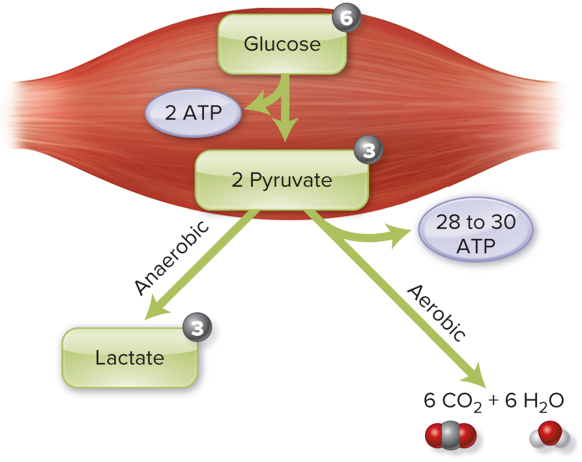
Figure 10-7: ATP Yield From Glucose
ATP yield: from aerobic versus anaerobic glucose use.
Circled numbers indicate number of carbons in each molecule.
Access the text alternative for slide images
Notes:
Here we see the full process of breaking down carbohydrates for fuel.
It is a multi-step process that takes place in the cytosol and mitochondria of your cells. Glucose is our first source of fuel. We can break down glucose regardless of oxygen being available in our cells. The first step of breaking down glucose for ATP doesn’t require oxygen – it is an anaerobic process. All your cells can do it. It doesn't matter if you have oxygen. If you're going really fast, you are going to use glucose. You’re going to rely on carbohydrates for that quick burst of energy, speed, and power.
so your cells can partially break down glucose to quickly resupply ATP when activity is short and intense. We gain 2 ATP from each molecule of glucose.
If you are going at a slower pace, you can get more oxygen. Then you can start to use these other sources of fuel. You’re going to start with glucose and metabolize it completely. That takes place in the mitochondria, and those processes require oxygen. Also, fat and protein are metabolized in the mitochondria, and it takes oxygen to be able to do that. So, if you want to be able to use your fat for fuel, it needs to be at a slower pace and less intense. You need to be able to have plenty of oxygen available.
So, if we completely break down glucose in the process that uses oxygen, we get about 30 ATP. We can be a lot more efficient if we're going at a slower pace. We can also start to use fat and protein for fuel. The basic message of this is that quick, high-energy, or high-intensity is going to use glucose or carbohydrates. Slower or lower-intensity is going to use more fat and maybe even some protein, but hopefully, you don't have to use a lot of protein. So, these processes are a little bit slower and they also require plenty of oxygen – they are aerobic processes. So, if our activity takes longer than 2 minutes and is performed at a slower pace, when we have plenty of time and plenty of oxygen, we can fully break down glucose and also use fatty acids and amino acids to synthesize ATP.

Slide 33
Aerobic Metabolism: Carbohydrates 2
When muscle glycogen is depleted.
  Blood glucose declines: athletes “hit the wall.”
  To avoid glycogen depletion:
    Maximize glycogen storage before exercise.
    Supply carbohydrates during activity.
    Replenish glycogen stores between events.
Notes:
By now, you recognize that our exercising muscles use glucose for fuel. I want to remind you that glycogen is our body’s storage form of glucose. Our liver and muscle tissues store glycogen, and we can break down that glycogen to yield glucose when we need it. When you exercise for an extended period of time, the glycogen in your muscles can be broken down so your muscles have glucose to use for fuel. The glycogen in your liver can be broken down to glucose and released into the bloodstream to maintain your blood glucose levels. Blood glucose can be taken up by any cells, including exercising muscles and your brain.
On average, adults store about 1800 kcal worth of glycogen. During endurance activities, like a long bicycling event or a marathon, there comes a point when your body’s glycogen stores get depleted. This can lead to low glucose levels and an overwhelming sense of fatigue. Athletes call this “hitting the wall.” Cyclists, in particular, call it “bonking.” Later in this chapter, you will learn about carbohydrate loading, which is a strategy endurance athletes use to maximize glycogen stores before an event. Another way to prevent glycogen depletion is to consume some carbohydrates while exercising, usually in the form of a sports drink or an energy gel.
After an event, an athlete will want to consume carbohydrates to replenish the glycogen that was used up during endurance activity. This is particularly important if there’s another workout that same day or the next day. This just makes sure there will be enough glucose, which our cells can use for fuel during activities of any duration and any intensity.

Slide 34
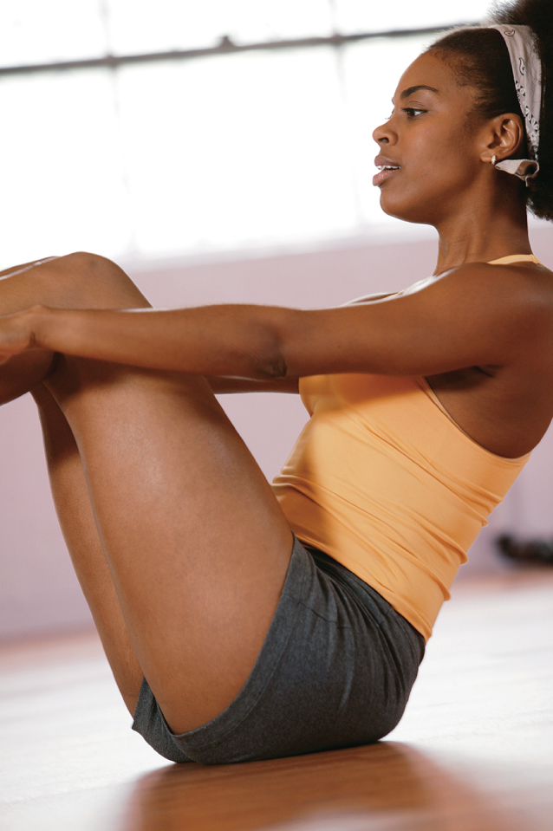
Aerobic Metabolism—Fat 1
Majority of energy stored in the body is fatty acids.
  Converted to ATP by muscle cells.
  Released from adipose tissue depots into bloodstream, travels to muscles.
  Used as activity increases from low to moderate pace.
Fatty acids come from all over the body, not necessarily from fat stored near active muscles.
This is why spot reducing does not work.
Comstock/Getty Images
Physical activity can tone muscles near adipose tissue but does not preferentially use those stores.
Notes:
The majority of the stored energy is found in the fatty acids. During physical activity, fatty acids are released from various adipose tissue depots into the bloodstream and travel to the muscles, where they are taken into each cell and broken down aerobically to carbon dioxide and water.
Some of the fat stored in muscles (intramuscular triglycerides) also is used, especially as activity increases from a low to a moderate pace.

Slide 35
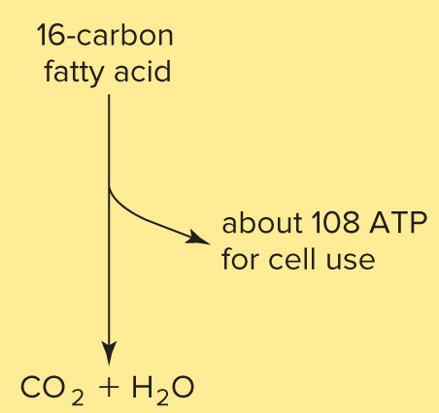
Figure 10-9: Aerobic Metabolism—Fat
Fat supplies more than 2× the energy of carbohydrate.
Ability of muscles to use fat for fuel depends on the intensity of exercise.
Becomes more important energy source as exercise duration increases.
During a 5-mile run, 50:50 ratio of fat-to-carbohydrate used.
ATP yield from aerobic fatty-acid utilization.
Each triglyceride yields 3 fatty acids and a glycerol molecule.
Notes:
Fatty acids can be broken down for fuel when there’s plenty of time and plenty of oxygen.
Fatty acids provide most of our ATP when we’re at rest.
During low or moderate intensity exercise, it’s about a 50:50 mix of carbs and fat (with a small contribution from amino acids).
During high intensity activity, though, there is just not enough time or oxygen for cells to effectively use fatty acids for fuel.
Fats yield a lot of energy!
Remember that a triglyceride is three fatty acids bound to a glycerol backbone.
Each of the three fatty acids can be cleaved from the glycerol backbone, transported into the mitochondria, and broken down to yield the chemical energy to make ATP.
Fatty acids vary in length, but most of the fatty acids in our foods and in our bodies are long-chain fatty acids.
One 16-carbon fatty acid can be broken down to yield 108 molecules of ATP!

Slide 36
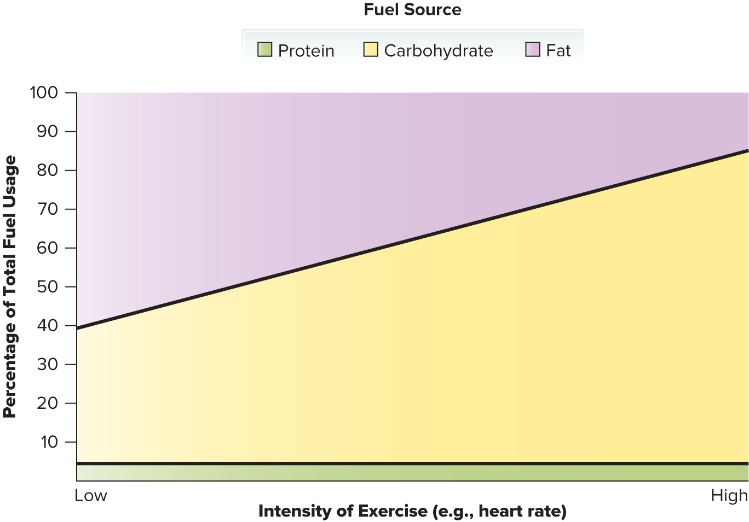
Figure 10-10: Fuel Use and Exercise Intensity
At rest or during light activity, nearly equal amounts of carbohydrate and fat are used to generate ATP.
As activity intensifies, anaerobic processes supply quick fuel; proportion of carbohydrates used increases.
Except during endurance exercise, little protein is used for fuel.
Notes:
Figure 10-10 shows the generalized relationship between fuel use and exercise intensity.
At rest or during light activity, nearly equal amounts of carbohydrate and fat are used to generate ATP.
As activity intensifies (e.g., sprinting), anaerobic processes supply quick fuel, so the relative proportion of carbohydrates used for fuel increases.
Except during endurance activities, very little protein is used for fuel.

Slide 37
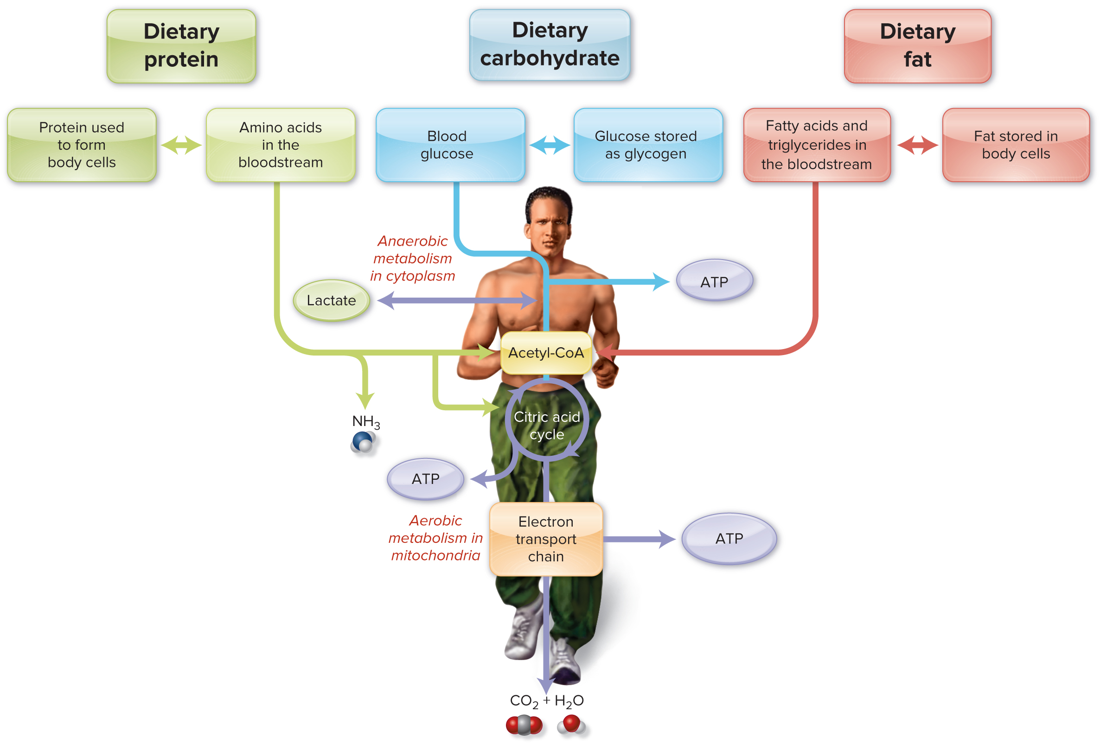
Figure 10-8: ATP Formation from Carbohydrate, Fat, and Protein
Along with phosphocreatine, all 3 macronutrients may be used for ATP synthesis, but glucose and fatty acids are primary sources.
Glucose may be broken down anaerobically or may undergo complete aerobic metabolism.
Products of fatty-acid breakdown are used for aerobic metabolism.
Although limited, products of amino-acid breakdown are used for the aerobic pathway.
Many vitamins and minerals participate in these metabolic pathways.
Access the text alternative for slide images
Notes:
Just to recap, during activity, we can use the chemical energy in glucose, fatty acids, or amino acids to synthesize ATP from ADP.
That glucose can come from the diet - starches and sugars in our dietary pattern - or it can be derived from the breakdown of glycogen that is stored in the liver and muscle tissue.
Fatty acids can come from triglycerides in the diet or from the triglycerides stored in our cells.
Amino acids can come from food proteins or the recycling or catabolism of body proteins.
Usually our cells rely primarily on glucose and fatty acids for fuel, with a minor contribution from amino acids.

Slide 38
Aerobic Metabolism—Protein
During rest and low to moderate intensity exercise
  Provides approximately 5% of energy needs.
During endurance exercise
  Provides 10% to 15% of energy needs.
Branched-chain amino acids provide most energy.
Resistance exercise uses less protein.
Average dietary pattern:
  Provides ample amount of these amino acids.
  Supplements not needed.
Notes:
As long as we have glucose and fatty acids to burn as fuel, it is really not efficient for your cells to use amino acids as fuel. Amino acids are typically spared for tissue synthesis and repair. Also, remember that use of amino acids for fuel generates ammonia, which must be converted to urea and excreted by the kidneys. Usually, only about 5% of all the ATP we make in a day comes from the metabolism of amino acids. Do some athletes use more amino acids than others? Is it the endurance athletes? Or the strength-trained athletes?
You may be surprised to find out that endurance athletes will actually burn slightly more amino acids than strength-trained athletes. But if you think about it, what fuels are being put to use with strength training? When the athlete is lifting the weight, that’s a short burst of intense exercise. What do your cells use for fuel during that brief moment? Glucose. Most of the workout, however, is resting between reps. During those times, the cells are using a mixture of glucose and fat. Strength-trained athletes do use extra amino acids, but not for energy. They will use their amino acids after the workout, in the recovery phase, to synthesize lean tissue.
During endurance activity, however, athletes will end up using more amino acids for fuel – maybe as high as 10% or 15% of the energy to make ATP will be derived from amino acids. It’s still not the main source of fuel, though.
Also, it’s important to note that most athletes – endurance or strength-trained – do not need any special protein or amino acid supplements. Eating a varied diet that meets overall calorie needs usually supplies enough protein for athletes.

Slide 39
Physical Training Affects Fuel Use
“Training Effect” occurs when starting regular exercise.
  Initially tire easily in about 20 minutes.
  Months later, may go 1 hour plus before fatigue.
Caused by changes in ability of cells to generate ATP:
  Increased insulin sensitivity.
      More glucose transported from bloodstream into cells.
  Increased muscle ability to store glycogen.
  Increased storage and use of triglycerides.
  More efficient protein/amino acid use.
  Increased ability to convert food energy to exercise fuel.
Notes:
As people start exercising regularly, they experience a training effect.
Initially, these individuals might be able to engage in physical activity for 20 minutes before tiring.
Months later, activities can be extended to an hour before they become fatigued.
The training effect results from changes in the ability of exercising cells to use food fuel to generate ATP.
Almost immediately after a person begins a physical activity program, both aerobic and strength training improve the insulin sensitivity of cells.
In other words, more glucose can be transported from the bloodstream into the cells, where it can be broken down either anaerobically or aerobically.

Slide 40
Table 10-2: Energy Sources Used by Muscle Cells
Energy Source | When in Use | Activity
ATP | At all times | All types
Phosphocreatine (PCr) | All physical activity initially; short bursts up to 10 seconds | Throws, jumps, or 100- to 400-meter sprints
Carbohydrate (anaerobic) | High-intensity activity, especially lasting 30 seconds to 2 minutes | 200-yard (about 200-meter) sprint
Carbohydrate (aerobic) | Physical activity lasting 2 minutes to several hours; the higher the intensity, the greater the use | Basketball, swimming, jogging, power walking
Fat (aerobic) | Activities lasting more than a few minutes, greater amounts are used at lower intensities | Long-distance running or cycling; much of fuel used in a 30-minute brisk walk
Protein (aerobic) | Low amount used during all activities; slightly more in endurance exercise, especially when carbohydrate fuel is depleted | Long-distance running
Notes:
Table 10-2 summarizes what we have just discussed about energy sources.
In the short term, our cells have two options to quickly resupply ATP.
The other high-energy molecule in our cells is called phosphocreatine. During short bursts of intense activity, our cells can break off the phosphate group from phosphocreatine and use that chemical energy to add the phosphate group back onto ADP to make ATP. Our cells make phosphocreatine, but some athletes also take creatine supplements as an ergogenic aid to attempt to boost athletic performance. There’s a section at the end of our chapter about ergogenic aids, including creatine.
Also, our cells can use carbohydrate, specifically glucose, in a hurry. Breaking down glucose takes multiple steps, but the first few steps can yield some ATP really quickly. That’s enough to keep our muscles working for up to 2 minutes. So, in the short term, for short duration, high intensity activity, we use up what little ATP is in our cells, we can resupply ATP by using the chemical energy in phosphocreatine, or by the partial breakdown of carbohydrates.
If we need to sustain muscular activity for longer than 2 minutes, our cells will continue to break down glucose and also start to use fatty acids. Amino acids can also contribute some chemical energy for physical activity. However, if we consume adequate carbohydrates and fat, the use of amino acids as a source of fuel will be minimal.
Remember that carbohydrates are the muscle cells’ preferred source of quick energy. This is because we can break down glucose quickly, even when oxygen is in short supply. This is what we need for short bursts of intense activity, such as sprinting, jumping, or lifting heavy weights. When our activity is of longer duration, but lower intensity, our cells can use a mixture of carbohydrates and fats. Our cells require oxygen to utilize fats and to fully break down carbohydrates. So, for short bursts of intense activity; your cells need carbs. For longer duration, lower intensity activity, you’ll use mixture of carbs and fats (along with a small amount of protein).

Slide 41
Section 10.4: Nutrient Recommendations for Active Adults and Athletes—Concepts
What does it mean to “cut weight” before a competition? How may this affect physical performance?
Greta, a point guard on the women’s basketball team, complains of chronic fatigue. Describe three nutritional concerns you would investigate.
During one day of preseason training for football, David loses 7 pounds as a result of sweat losses. How much fluid should he drink to rehydrate after practice?

Slide 42
Calorie Recommendations 1
Individual needs vary
Monitor weight, body fat
  If weight falls, increase calories.
  If weight and body fat increase, reduce calories and increase activity.
Estimate of calories required to sustain moderate activity:
5 to 8 kcal per minute.
Calories required for sports training or competition must be added to those used to carry on normal activities.
Notes:
Now, we have a basic understanding of what our muscles are using for fuel during exercise. Let’s talk about the specific needs of the athlete. Let’s talk about calories first. I can't give you a blanket recommendation for every athlete because every athlete’s different. Even individual athletes are going to go through periods of training and being on-season and off-season. It's going to vary based on what the athlete’s doing, how big that athlete is, whether they’re male or female, and their body composition.
For moderate activity, there's a general estimate of five to eight calories per minute for moderate activity.
The best way to find out if an athlete's getting enough energy is just to measure their weight over time. If their weight changes, that's showing that there's an imbalance in the energy balance equation. If their weight goes up, then they're getting more calories than they actually need. If their weight is dropping, then they're not getting enough calories. We can make an estimate based on some equation of how many calories an athlete needs, but the best way to measure that is to actually track their weight over time. Desirable body fat for athletes is here in numbers. For females, it’s a little bit higher than for males. This is a little bit lower than what is typical for a non-athlete. In general, we talked about obesity, and a body fat level higher than 25 percent for men is considered obese.

Slide 43
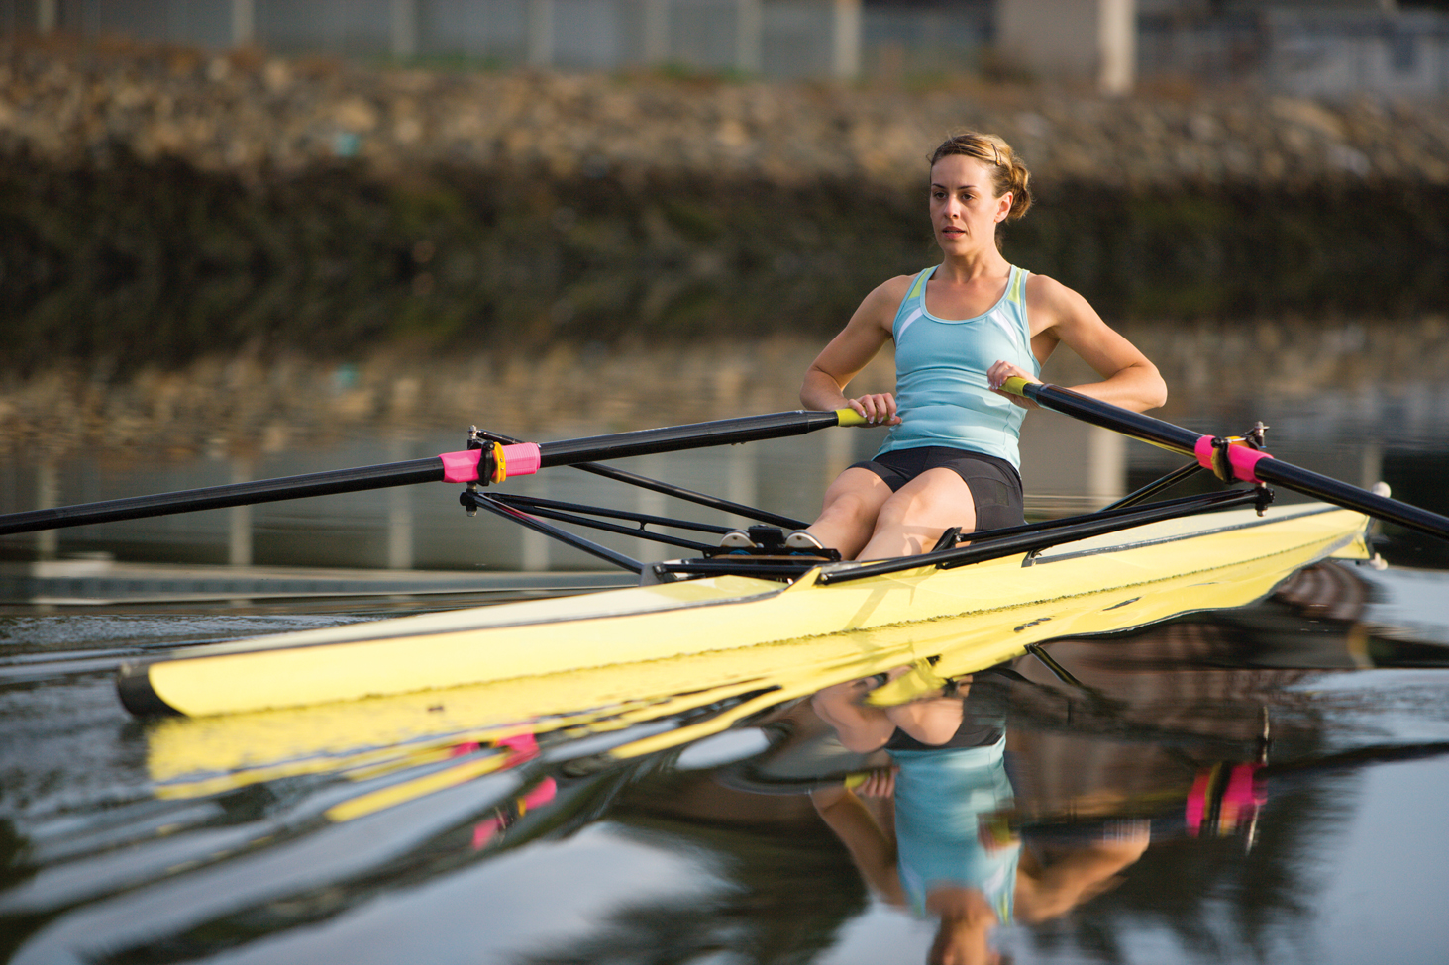
Calorie Recommendations 2
Caution to athletes in sports with weight classes.
  Many unhealthy methods used to lose weight.
  Gradual, sustained calorie reduction is best approach.
Intense athletic training may require thousands of additional calories.
Increased food intake should easily provide ample protein and other nutrients to support activity.
Ty Milford/Aurora Open/ Getty Images
Notes:
I want to point out something called “making weight.” Wrestling would be an example of when this happens. There are certain sports where there are weight classes. When you're competing against other people, you're competing in a weight class. If you can get down and compete in the lower weight class, you might have a competitive advantage over these people that are smaller than you. Some people will try drastic measures to get down into a lower weight class to be able to compete against smaller athletes. Some of the practices they have used to make weight are not good. Some examples include using diuretics to lose extra weight through urine. They may be doing things to dehydrate themselves, like not drinking enough, sweating it out by wearing a sauna suit, or hanging out in a sauna.
How do you feel when you’re dehydrated? You feel terrible. You may have headaches, grogginess, and fatigue. That's not really supporting good sports performance at all. Most measures to cut weight actually dehydrate the body. Actually, when you lose weight rapidly, you’re going to start to break down your muscle tissue. That's not a good, healthy practice. A lot of high school athletic associations and college athletic associations will try to make you decide what weight class you are going to be at the beginning of the season. This kind of avoids these drastic measures of cutting weight in the middle of the season to try and compete against the smaller athletes. Sports nutrition experts and coaches are trying to get athletes to not do that because it's very dangerous. You could become dehydrated, and it could cause health problems, kidney problems, and even death.

Slide 44
Relative Energy Deficiency in Sport (RED-S)
Female athlete triad syndrome:
Historically been linked to low energy availability (LEA)
Concept has been expanded to include male athletes.
Extends beyond bone and menstrual health.
Highest prevalence of LEA in: weight-sensitive endurance sports.
Relative energy deficiency in sport (RED-S)
addresses full range of concerns:
amenorrhea (females)
reduced testosterone levels and libido (males)
suboptimal bone health
increased risk of illness and injuries
gastrointestinal disturbances,
cardiovascular disease,
impaired training capacity, and poor performance.
Notes:
Right now, we're going through this change of name for the female athlete triad. Now, it's becoming more commonly known as relative energy deficiency in sport.

Slide 45
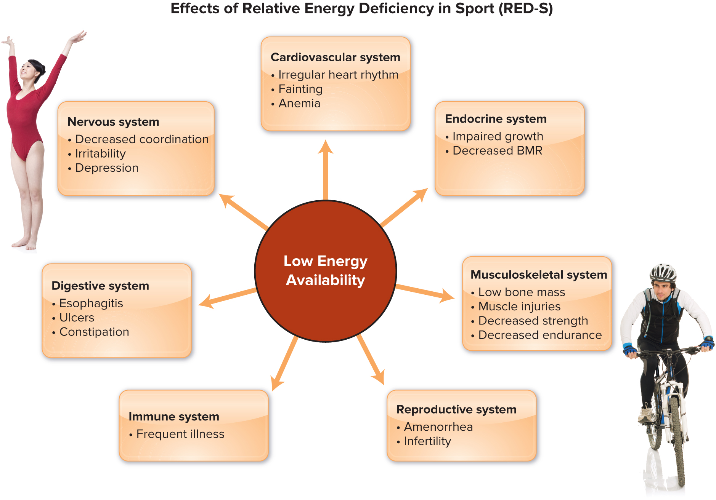
Figure 10-11: Relative Energy Deficiency in Sport
Photos: (a) Lane Oatey/Blue Jean Images/Getty Images; (b) Aaron Amat/Shutterstock
Access the text alternative for slide images
Notes:
FIGURE 10-11 illustrates the effects of relative energy deficiency in sport occurs when the athlete has low energy availability (with or without an eating disorder), which negatively impacts multiple body systems.
There is a combination of factors going on, and they all have to do with not getting enough energy. A person that is not getting enough energy in total is going to have poor bone health because it's going to affect hormone levels. Then they're also probably not getting enough calcium, so this is a combination of factors that lead to fractures. Recently, a gymnast came down wrong and broke her legs.
Not all gymnasts are subject to this, but in sports like gymnastics, figure skating, dancing, and diving, disordered eating is pretty common. A lot of sports that are judged on aesthetics have a big focus on maintaining a very lean body. That can lead to disordered eating or a full-blown eating disorder. So, we have low energy intake compared to needs. Then, because energy intake is low, reproductive functions slow down. That leads to problems with your bones. The biggest issue here, especially among female athletes, is that osteoporosis could occur at a young age. The combination of irregular menstruation, which is a sign of low hormones, and inadequate energy intake, could lead to fractures. It's not just the calcium, but low calcium is a big contributing factor.

Slide 46

Carbohydrate Recommendations
Main fuel for many types of activities.
Consume 45% to 65% of total calories from carbohydrate.
Activity Level | Grams Carbohydrate Per Kilogram Body Weight.
Light or skill-based | 3 to 5
Moderate intensity | 5 to 7
Training several hours per day | 12
High-carbohydrate foods should form the basis of the diet for athletes.
Notes:
Carbohydrates are a quick source of fuel. It’s our main fuel for most of our activity when we’re exercising.
Most athletes are going to need a little extra carbohydrate.
Typically, the American diet should provide 45 to 65 percent of our calories as carbohydrates. But, athletes need to lean toward the higher end. They may even need up to 70 percent because they’re going to use carbohydrates as fuel when they’re working out.
MyPlate is a good way to go about it because MyPlate is very balanced. Remember, it has the five food groups: dairy, fruits and veggies, grains, and protein.
They may need to have a few extra servings of grains, fruits, and vegetables to supply extra carbohydrates.
In general, each serving of grains gives us about 15 grams of carbohydrates. That would be a slice of bread, or half a cup of cereal.
Each piece of fruit or cup of fruit is about 15 grams of carbs.
Veggies vary; if they’re starchy vegetables like potatoes or corn, we get about 15 grams per cup.
The water-rich vegetables like broccoli and asparagus give us fewer carbs. Milk gives us carbs too, it provides about 12 grams per cup.

Slide 47
Table 10-3: Carbohydrate-Rich Foods: Starches
Starches—One Serving = Approximately 15 Grams Carbohydrate (80 kcal)
Dry breakfast cereal, ½–¾ cup | Baked potato, ¼ large
Cooked breakfast cereal, ½ cup | Bagel, ¼ (or 4 ounces)
Cooked rice, ⅓ cup | Bread, 1 slice
Cooked pasta, ⅓ cup | Pretzels, ¾ ounce
Cooked corn, ½ cup | Saltine crackers, 6
Cooked dry beans, ½ cup | Pancake, 4-inch diameter, 1
Notes:
Table 10-3 lists several carbohydrate rich foods.
Always b sure to check the Nutrition Facts label for carbohydrate content.

Slide 48
Table 10-3: Carbohydrate-Rich Foods: Vegetables and Fruits
Vegetables—One Serving = Approximately 5 Grams Carbohydrate (25 kcal)
Cooked vegetables, ½ cup
Raw vegetables, 1 cup
Vegetable juice, ½ cup
Examples: carrots, green beans, broccoli, cauliflower, spinach, tomatoes, and vegetable juice
Fruits—One Serving = Approximately 15 Grams Carbohydrate (60 kcal)
Canned fruit or berries, ½ cup | Grapes, 17
100% fruit juice, ½ cup | Grapefruit, ½
Apple or orange, 1 small | Peach, 1
Banana, 1 small | Watermelon cubes, 1¼ cups

Slide 49


Farm to Fork: Carrots and Beets
Store
Cut the tops off of your fresh carrots so they retain their moisture.
Remove beet greens and store beet roots unwrapped in the refrigerator and use them within 2 weeks.
Prep
Carrots and beets are more nutritious cooked.
Eat carrots with oil or fat to allow absorption of fat-soluble pro-vitamin A beta-carotene.
The skin helps retain the water-soluble nutrients while cooking and can be slipped off when cool.
Grow
Purple carrots are sweeter and higher in beta-carotene and purple anthocyanins than orange varieties.
Red beets are high in betalins, phytochemicals that may reduce cancer risk and other diseases.
Shop
Buy carrots and beets with the green tops attached.
Compared to fresh whole carrots, baby carrots are not as nutritious and frozen carrots have about half of the antioxidant value.
Canned beets are more nutritious with more antioxidant value.
Notes:
Carrots and beets are root crops with a wide range of nutrients, flavors, and health-promoting benefits.
Red beet juice has also been touted to enhance athletic performance.
The wild ancestor of carrots was purple, but most carrots grown in the United States are orange, a good indicator of the nutrients and other phytochemicals they contain, especially beta-carotene. Purple carrot varieties, which are sweeter and higher in beta-carotene and the purple pigments, anthocyanins. Red beets are high in betalins, phytochemicals that may reduce the risk of cancer and other diseases.
For the freshest and sweetest carrots and beets, buy them with the green tops still attached. They will be at most only a few weeks old. Refrain from buying baby or frozen carrots. Baby carrots originate from misshapen mature carrots that have been whittled down to a smaller uniform size, and the remaining inner core is not as nutritious as the outer part that is discarded. The peeling, processing, and freeze/thaw cycle of frozen carrots destroys about half of their antioxidant value. The canning of beets renders them more nutritious with more antioxidant value.
Cut the tops off of your fresh carrots so they retain their moisture. Remove beet greens and store beet roots unwrapped in the crisper drawer of the refrigerator and use them within 2 weeks.
Carrots and beets are more nutritious cooked. The heat breaks down cell walls and makes nutrients more bioavailable. Scrub carrots and beets, and cook them whole. Carrots can be sautéed or steamed to preserve more nutrients and sweetness. Eat carrots with oil or fat to allow best absorption of the fat-soluble beta-carotene, a precursor of vitamin A.
The skin of beets helps retain the water-soluble nutrients while cooking and can be slipped off when cool.

Slide 50
Table 10-3: Carbohydrate-Rich Milk and Sweets
Milk — One Serving = Approximately 12 Grams Carbohydrate
Milk, 1 cup | Soy milk, 1 cup
Plain low-fat yogurt, ⅔ cup
Sweets— One Serving = Approximately 15 Grams Carbohydrate (variable calories)
Cake, 2-inch square | Ice cream, ½ cup
Cookies, 2 small | Sherbet, ½ cup
Source: Modified from Choose Your Foods: Food Lists for Diabetes by the American Diabetes Association and Academy of Nutrition and Dietetics, 2014.

Slide 51
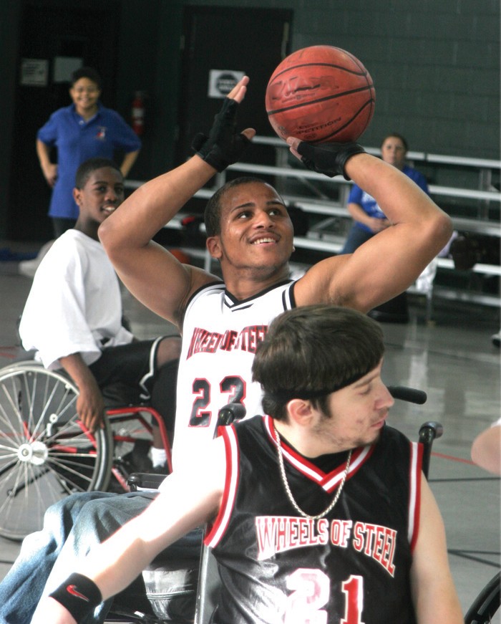
Fat Recommendations
Recommendation for athletes:
Up to 35% of total kcal
Rich in monounsaturated fats
Limit saturated and trans fat
The calories needed to perform come from carbohydrate, fat, and protein. The relative mix depends on the pace.
Realistic Reflections
Notes:
Our general recommendation for fat for athletes is the same as for non-athletes.
Twenty to 35 percent of total calories, and we want to make sure we're choosing healthy fats like unsaturated plant sources and some fish.
We want to choose healthy fats more often than solid saturated animal sources like beef, pork, and things like that. Focus on plant oils and focus on fish oils because those are going to be the unsaturated fats.
Lower intensity, longer duration exercises use more fat for fuel, which is shown in yellow.

Slide 52

Optimal Dose of Protein
Sport nutrition experts recommend:
  1.2 to 2.0 grams protein per kilograms of body weight
Needs met by a normal diet
  Protein supplements not needed
To promote muscle synthesis:
  0.3 grams/kg of high-quality protein per meal at 3 or more meals spaced throughout the day.
asife/Shutterstock
Rather than simply focusing on total protein intake, athletes should consume foods that provide 30 to 45 grams of high-quality protein per meal spaced throughout the day.
Notes:
How much protein do athletes actually need? Right now, the RDA for protein for all adults is eight grams per kilogram. There's no special RDA, according to the National Academy of Science, for athletes. But, a lot of sports nutrition experts have done studies, and they're finding that athletes perform optimally with higher intakes than 0.8 grams per kilogram.
Even though the RDA is still 0.8 grams per kilogram, most experts in sports nutrition will recommend anywhere up to two grams per kilogram. It's going to vary based on what you're doing. This high amount of two grams per kilogram is going to be for people who are just starting a strength training program. They're building muscle, and they're going to need that extra protein.
After that new muscle is built, and they’re just trying to maintain, they don't need two grams anymore. They can drop that down to 1.4 or 1.6. In between here, the endurance athletes are going to need a little extra because they're breaking down muscle too. They need to help their muscles repair. Also, they’re using extra amino acids for fuel during activity. A little bit higher than the RDA is best for athletes, but the RDA is still officially 0.8. Even though this sounds like a lot, it is not a lot. Most of us are probably getting that much without trying. It’s easy to eat that with a normal diet. You don't need supplements.

Slide 53
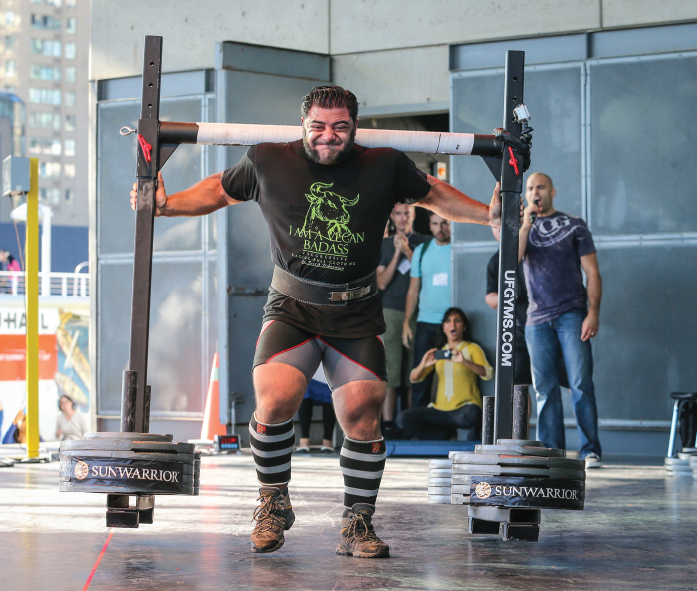
Ask the RDN: No Meat Athlete
Do strength-trained athletes need to ingest tuna, chicken, and lean beef at every meal to build muscle?
Patrik Baboumian is a strongman competitor and former bodybuilder who follows a vegan diet.
The plant-based protein sources that built his 250-pound physique include beans, peas, lentils, nuts, seeds, and protein shakes made with soy protein powder.
Baboumian was a world record-holder for the log lift in his weight class and was named Germany’s strongest man.
David Cooper/ Toronto Star via Getty Images
Notes:
The ASK the RDN is a response to this question:
Dear RDN: For a variety of reasons, I am considering switching to a vegan eating pattern. However, I am a sprinter on the college women’s swim-ming and diving team, and I want to make sure that a vegan diet would not affect my athletic performance. Can a “no-meat athlete” compete?
A well-planned plant-based diet can absolutely support optimal athletic performance.
From better weight management to reduced risk for chronic diseases, vegan diets offer many health benefits.
However, some nutrient needs may be difficult to meet with a plant-based diet. These include protein, iron, calcium, and vitamin B-12.
Patrik Baboumian is a strongman competitor and former bodybuilder who follows a vegan diet.
The plant-based protein sources that built his 250-pound physique included beans, peas, lentils, nuts, seeds, and soy.
Baboumian was a world record–holder for the log lift in his weight class and was named Germany’s strongest man.

Slide 54
Vitamins and Minerals
Athletes:
Needs for micronutrients are same or slightly higher than sedentary individuals.
Have higher calorie intake—increases vitamin and mineral intake.
Exceptions:
Events where low body fat is crucial.
Vegetarian athletes: Fortified foods or a balanced multivitamin and mineral supplement are beneficial.
Notes:
When it comes to vitamins and minerals, there are some specific things athletes should be thinking about. They don't have any special RDAs for any vitamins or minerals.
Regarding fluid balance, as we sweat, we're losing some electrolytes, so it's important to replace sodium and potassium.

Slide 55
B Vitamins
Support energy metabolism.
  Many function as coenzymes.
    Facilitate chemical reactions generating ATP from carbohydrates, protein, and fats.
    With athlete’s higher volume of energy metabolism, increased demand for coenzymes.
Support red blood cell health.
  Folate and vitamins B-6 and B-12 involved in the formation of healthy red blood cells, which transport oxygen.
Notes:
All those B vitamins are important, especially B-6 for amino acid conversions.
The closest we’re getting to having a specific RDA for athletes would be B-6.
B-6 is important for energy metabolism.
There's some pretty good research that athletes probably need more B-6.
However, most athletes get enough B-6 because as you increase your food intake to meet your energy needs, you're probably getting enough B-6. I
t's found in a variety of foods and it’s in a lot of protein foods, but also other food groups too

Slide 56
Antioxidant Nutrients
Prevent oxidative damage
  Vitamins E and C—Antioxidant properties
    Athletes—slightly higher needs
Eat foods rich in antioxidants
  Fruits, vegetables
  Whole grain breads and cereals
  Vegetable oils
Large doses of vitamins E and C require more study.
  Not currently an accepted part of the dietary guidance for athletes.
Notes:
Antioxidants are important because you’re putting a lot of stress on your body, and you're using a lot more fuel.
You're creating more free radicals, so you need more antioxidants to combat that.
Vitamin C and vitamin E are good for that. You don't need a supplement. Just eat your fruits and veggies.

Slide 57
Iron
Athletes need iron status checked regularly.
Iron deficiency impairs performance.
  Women at risk because of iron loss with menstruation.
  Sports anemia: increase in plasma volume but not RBCs.
Focus on iron-rich foods.
Iron supplements
  May cause toxic effects.
  Negative impacts on performance.
Notes:
Iron is important for blood health, and we need our blood to be healthy.
We need our red blood cells to get oxygen to our cells so that we can use that oxygen for metabolizing fuel. Iron is important.
If you have anemia and iron deficiency, that's definitely going to affect your performance because you're not getting enough oxygen to your cells. Sports anemia and iron deficiency anemia are not the same thing. Iron deficiency anemia is when you're not getting enough, and your red blood cells are unhealthy. They don't have enough hemoglobin, and they can't transport oxygen very effectively. When you first start a sports training program, sports anemia is pretty common. It's not really true anemia, it just means that your blood volume has expanded, so your red blood cells are diluted in your blood. It looks like your red blood cell levels are low, but just because your plasma volume has expanded. This is a temporary condition. It doesn't affect your performance. You can't really tell by looking at your blood if it's sports anemia or iron deficiency anemia, so it's a good idea to screen for these things as we go. Women are at particular risk because of menstruation. Sometimes athletes, in general, have some GI bleeding. It sounds terrible, but as you run, it's pretty common to have a little GI bleeding from the stress of exercising. Also, when your feet strike the ground, that can break your red blood cells and create a little hemolysis, so your red blood cells break apart. Athletes are at higher risk for anemia for those reasons. If there's a weight restrictive sport, people who aren't getting enough calories might be restricting good sources of iron, so they might be low. Just focus on iron-rich foods to prevent it. Once iron deficiency anemia occurs, can you fix it with food? You can't. Once you get anemia, you need to take a supplement to fix it. It’s something to check and something you should screen for periodically throughout the season for athletes.

Slide 58
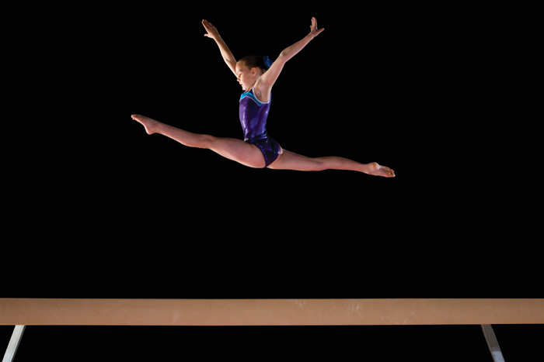
Calcium
Calcium deficiency increases risk of stress fractures.
  Female athletes who do not menstruate regularly have bones far less dense than those of nonathletes and female athletes who menstruate regularly.
Juice Images Ltd/Getty Images
Calcium intake is important.
  Extra calcium does not compensate for effects of menstrual irregularities.
Notes:
Bone health is super important for athletes. They’re putting stress on their bones, and that helps build strong bones, but they need the raw materials available to do that. They need to have calcium and other bone minerals. They need to have enough vitamin D to absorb calcium. Another important thing about vitamin D in athletes is it helps your muscles to be healthy. It's important for muscle synthesis, and athletes that don't get enough vitamin D might have frequent muscle injuries.
B-6 is important for energy metabolism
Calcium is important for your bones, especially for female athletes, because female athletes tend to not get enough. Women, in general, tend to not get enough calcium, but this could be the issue for men as well if their calorie intake and calcium intake is low.

Slide 59
Vitamin D
Relationship found between vitamin D status and:
Injury prevention.
Improved neuromuscular function.
Enhanced muscle size.
Decreased inflammation.
Reduced risk of stress fractures.
Vitamin D deficiency a risk for
Athletes who live at latitudes above the 35th parallel.
Athletes who predominately train indoors.
Current data do not support vitamin D as an ergogenic aid.
Notes:
Athletes need to have enough vitamin D to absorb calcium.
Another important thing about vitamin D in athletes is it helps your muscles to be healthy.
It's important for muscle synthesis, and athletes that don't get enough vitamin D might have frequent muscle injuries.

Slide 60
Fluid
Needs of average adults
  9 cups per day for women.
  13 cups per day for men.
  Athletes need more.
Maintenance of body’s cooling system.
  Water helps dissipate heat from working muscles.
  Avoid losing more than 2% of body weight during exercise.
Dehydration:
  Can lead to illness and death.
  Decreases endurance, strength, performance.
  Must be avoided during physical activity in hot, humid environments.
Notes:
Regarding fluid balance, as we sweat, we're losing some electrolytes, so it's important to replace sodium and potassium. You need fluid as an athlete because that's the main way you cool your body, so it's going to help dissipate heat and prevent heat-related injuries like heat stroke. Also, it's going to transport nutrients and oxygen to all your cells. You need to have that fluid available. This is for the average adult: nine cups of fluid per day for women and 13 cups per day for men is recommended. For athletes, they are going to need more than that because they're losing extra in sweat. Just like calories, I can't give you a specific number. It's just going to depend on each athlete. It's going to depend on the temperature, where they’re exercising, and it's going to depend on how much they sweat. It also depends on how long they exercise. Lots of different variables are going on there.
The idea is for athletes to avoid losing more than two percent of body weight during exercise. Once you lose two percent of your weight as fluid, that's when you’ll start to have symptoms of dehydration. Ideally, you would keep track of your weight loss from before and after your workout. Then from training, you would know how much you're sweating and about how much you need to replenish during activity and after activity. To replace a pound of weight loss, you need to drink about two or three cups of water. A pint is two cups, and that's about a pound, but you need a little extra because you're going to pee some extra out. Two to three extra cups per day is the general recommendation to replace a pound of weight loss.
You need fluid as an athlete because that's the main way you cool your body, so it's going to help dissipate heat and prevent heat-related injuries like heat stroke. Also, it's going to transport nutrients and oxygen to all your cells. You need to have that fluid available. This is for the average adult: nine cups of fluid per day for women and 13 cups per day for men is recommended. For athletes, they are going to need more than that because they're losing extra in sweat. Just like calories, I can't give you a specific number. It's just going to depend on each athlete. It's going to depend on the temperature, where they’re exercising, and it's going to depend on how much they sweat. It also depends on how long they exercise. Lots of different variables are going on there.
The idea is for athletes to avoid losing more than two percent of body weight during exercise. Once you lose two percent of your weight as fluid, that's when you’ll start to have symptoms of dehydration. Ideally, you would keep track of your weight loss from before and after your workout. Then from training, you would know how much you're sweating and about how much you need to replenish during activity and after activity. To replace a pound of weight loss, you need to drink about two or three cups of water. A pint is two cups, and that's about a pound, but you need a little extra because you're going to pee some extra out. Two to three extra cups per day is the general recommendation to replace a pound of weight loss.
You need fluid as an athlete because that's the main way you cool your body, so it's going to help dissipate heat and prevent heat-related injuries like heat stroke. Also, it's going to transport nutrients and oxygen to all your cells. You need to have that fluid available. This is for the average adult: nine cups of fluid per day for women and 13 cups per day for men is recommended. For athletes, they are going to need more than that because they're losing extra in sweat. Just like calories, I can't give you a specific number. It's just going to depend on each athlete. It's going to depend on the temperature, where they’re exercising, and it's going to depend on how much they sweat. It also depends on how long they exercise. Lots of different variables are going on there.
The idea is for athletes to avoid losing more than two percent of body weight during exercise. Once you lose two percent of your weight as fluid, that's when you’ll start to have symptoms of dehydration. Ideally, you would keep track of your weight loss from before and after your workout. Then from training, you would know how much you're sweating and about how much you need to replenish during activity and after activity. To replace a pound of weight loss, you need to drink about two or three cups of water. A pint is two cups, and that's about a pound, but you need a little extra because you're going to pee some extra out. Two to three extra cups per day is the general recommendation to replace a pound of weight loss.

Slide 61
Fake or Fact? 2
Thirst is a good indicator of hydration status.
FAKE NEWS
Thirst is a late sign of dehydration. An athlete who drinks only when thirsty may take 48 hours to replenish fluid losses. After several days of training, an athlete relying only on thirst can build up a fluid debt that will impair performance. For healthy athletes, pale yellow urine is a good indicator that fluid needs are being met.
THE FACTS
Notes:
The fact is that thirst is a late sign of dehydration. An athlete who drinks only when thirsty may take 48 hours to replenish fluid losses. After several days of training, an athlete relying only on thirst can build up a fluid debt that will impair performance. For healthy athletes, pale yellow urine is a good indicator that fluid needs are being met.

Slide 62
Fluid Replacement
Thirst: not reliable indicator of fluid needs.
Check urine color, no darker than lemonade.
  Before event:
    Drink fluid freely 24 hours before event.
    Drink 5 to 7 milliliters per kilograms of body weight at least 4 hours before exercise.
  During event:
    Consume 1.5 to 3.5 cups per hour for events lasting longer than 30 minutes.
  After exercise:
    Within 4 to 6 hours, consume 2 to 3 cups of fluid for every pound lost.
Notes:
Most people, if they just drink to satisfy their thirst, they're fine.
For athletes they're not going to get thirsty enough to replenish their hydration.
They need to realize that they need to focus on hydration.
They need to drink beverages before, during, and after exercise.
The whole point is to avoid losing more than two percent of your weight as fluid.
One good way to look at it is to check your urine color.
It should be a pale-yellow straw color and not any darker than that.
Be careful because drinking too much fluid could lead to water intoxication.
Know yourself through training and how much you're going to lose and drink to replenish that.

Slide 63
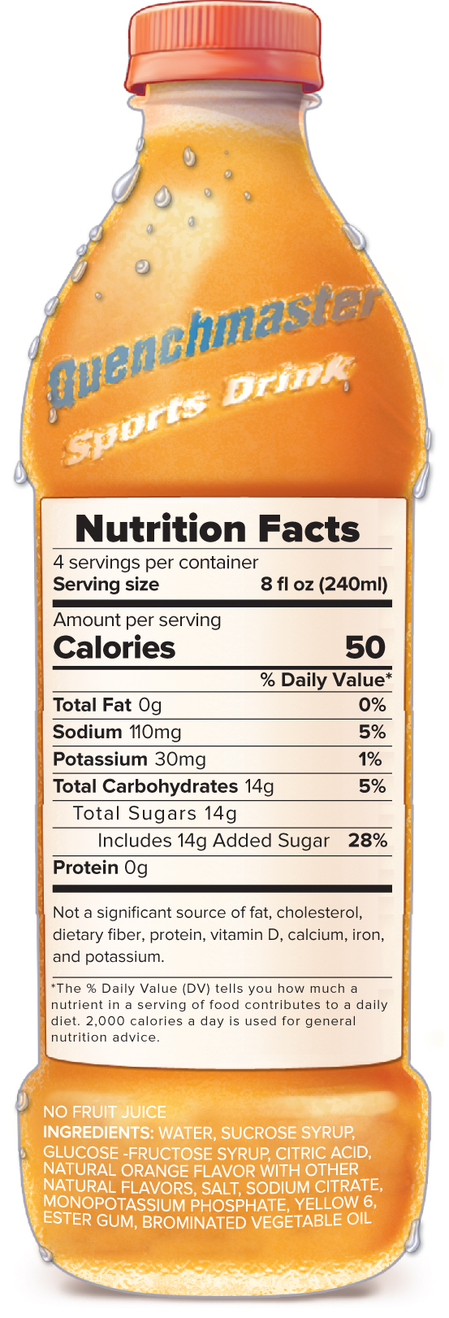
Figure 10-12: Sports Drinks
For activities more than 60 minutes.
  Help maintain blood glucose level and blood volume.
  Delay “hitting the wall.”
Typically contain added sugars (6% to 8%), sodium, and potassium.
Fuels working muscles, and is well tolerated.
For activities less than 60 minutes.
  Water lost through sweat is main concern.
  Nutrients easily replaced by diet.
Sugars total 14 grams per cup (240-mL) serving.
Access the text alternative for slide images
Notes:
Sports drinks have a really good place in sports nutrition.
Are they necessary for everybody? No, they're not.
They have less sugar than soda and less sugar than fruit juice.
They're okay as a beverage for the average everyday person, but they’re probably a source of extra calories if you're not doing endurance exercise.
They are great when we're doing endurance exercises like long-distance running or cycling.
If you’re active for an hour or more, you probably need to replace not just fluid but also electrolytes and carbohydrates.
Sports drinks replace your fluid, but they also give you some carbohydrates to maintain your blood glucose to prevent hitting the wall.
They also give you some electrolytes to replace the sodium and the chloride that you're losing when you sweat.
They are formulated to meet the needs of an athlete.

Slide 64
Table 10-4: Popular Energy Drinks
Beverage | Container Size (fl oz) | Caffeine (mg) | Energy (kcal) | Sugars (g)
Full Throttle® | 16 | 164 | 228 | 60
Monster Energy® | 16 | 164 | 233 | 54
Monster Lo-Carb® | 16 | 144 | 24 | 7
Monster Zero Sugar® | 16 | 140 | 0 | 0
NOS® | 16 | 169 | 218 | 56
Red Bull® | 8.4 | 75 | 112 | 27
Red Bull Sugar free® | 8.4 | 76 | 13 | 0
Red Bull The Blue Edition® | 8.4 | 80 | 110 | 27
Rockstar® | 16 | 164 | 288 | 61
Notes:
Table 10-4 compares the caffeine and calorie contents of sev-eral top-selling energy drinks.

Slide 65
Heat Exhaustion
First stage of heat-related illness
Symptoms:
    Profuse sweating
    Headache
    Dizziness
    Nausea
    Muscle weakness
    Visual disturbances
    Flushed skin
    Hyperthermia
    Heat cramps
Heat stress causes depletion of blood volume due to fluid loss.
Recommended treatment:
  Move to cool environment.
  Remove excess clothing.
  Cool the skin with ice packs or cold water.
  Replenish lost fluids and electrolytes.
Notes:
As environmental temperature rises above 95°F (35°C), virtually all body heat is lost through the evaporation of sweat from the skin.
As humidity rises, especially above 75%, evaporation slows and sweating is insufficient to cool the body.
The result is rapid fatigue, increased work for the heart, and difficulty with prolonged exertion.
Heat-related injuries—heat exhaustion, heat cramps, and heatstroke—can be deadly. To decrease the risk of developing heat-related injuries, watch for rapid body-weight changes (2% or more of body weight), replace lost fluids, and avoid exercising under extremely hot, humid conditions.
Here we see the symptoms of the first stage of heat-related illness, heat exhaustion.

Slide 66
Heat Cramps
Frequent complication of heat exhaustion:
  Exercising for several hours in a hot environment.
  Experienced large sweat losses.
  Consumed large volume of water without replacing electrolytes.
Symptoms:
  Painful skeletal muscle cramps.
  Involuntary muscle spasms
Recommended treatment:
  Replenish lost fluids and electrolytes immediately.
Notes:
Heat cramps are a frequent complication of heat exhausation.
We see here how important it is to replenish lost fluids and electrolytes immediately.

Slide 67
Heatstroke
High blood flow to working muscles:
  Overloads body’s cooling system.
  Sweating ceases because blood circulation reduced.
  Internal body temperature reaches 104°F.
  Fatality rate high: Death results in 10% of cases.
  Seek Professional Medical Attention
Symptoms:
  Hyperthermia
  Hot, dry skin
  Nausea
  Confusion
  Irritability
  Poor coordination
  Fainting
  Seizures
  Coma
Recommended treatment:
  Cool the skin with ice packs or cold water.
Notes:
We are getting more serious here with heatstroke which requires medical attention.

Slide 68
Water Intoxication
Possible to drink too much water.
  Results in low blood sodium (hyponatremia).
  Bloating
  Puffiness
  Weight gain
  Nausea
  Vomiting
  Headache
  Confusion
  Delirium
  Seizures
  Respiratory distress
  Loss of consciousness
  Possibly death if left untreated
Notes:
It is also possible for some athletes to drink so much water that they develop water intoxication (hyponatremia).
Recall that hyponatremia causes cardiovascular and neurological problems and can lead to death.
Symptoms of hyponatremia are listed here and could even lead to death if untreated.s

Slide 69
Section 10.5: Recommendations for Endurance, Strength, and Power Athletes—Concepts
Which nutrient(s) should be emphasized in a pre-event meal for an endurance athlete? Provide an example of a suitable pre-event meal for a long-distance cyclist.
What is carbohydrate loading? List three sports for which carbohydrate loading could enhance performance.
Why is a combination of carbohydrates and proteins recommended for recovery after resistance training? Suggest a suitable recovery meal.

Slide 70
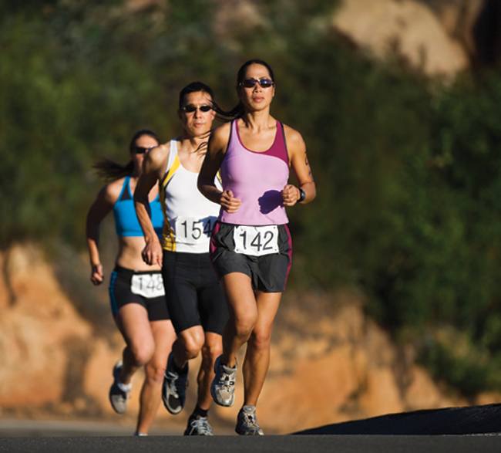
Carbohydrate Loading
Maximizes glycogen storage before the event.
Events lasting longer than 90 minutes.
Tapering of exercise while increasing carbohydrate intake.
Increases muscle glycogen stores 50% to 90%.
Additional water weight, possible disadvantage.
Try it during training first.
Fuse/Corbis/Getty Images
Notes:
We’re using carbohydrates during our exercise, so it's possible we could deplete our glycogen stores.
Then we would feel tired and feel like we can't go on.
One method athletes use to alleviate that problem of hitting the wall or bonking is carbohydrate loading.
That's only going to be beneficial for endurance activity.
For short bursts of intense exercise, you don't have enough time to use your glycogen. There are some drawbacks because when you store extra glycogen in your muscles, you also store some water with it. Some people say this makes their muscles feel stiff and heavy. It also causes a little bit of weight gain, which is probably not great for a runner who’s trying to be fast because they have to drag that extra weight.
Now, we have a lot of products we can use in the middle of our activity, like sports drinks and energy gels. We probably don't need to do this carbohydrate loading. Some people still do this, but really it's not in style anymore amongst sports dietitians. Now, we’re providing carbohydrates during exercise more.

Slide 71
Carbohydrate Loading: Beneficial?
Carbohydrate Loading May Be Beneficial for These Activities
Marathons
Long-distance swimming
Cross-country skiing
30-kilometer runs
Triathlons
Tournament play basketball
Cycling time trials
Notes:
When I say endurance, I mean activity for at least 60 minutes. Long-distance running, long-distance cycling, a triathlon, or something like that would be an endurance activity.

Slide 72
Table 10-6: Sample Carbohydrate-Loading Regimen
Days Before Competition | 6 | 5 | 4 | 3 | 2 | 1
Physical activity time (minutes) | 60 | 40 | 40 | 20 | 20 | Rest
Carbohydrate intake (grams) | 450 | 450 | 450 | 600 | 600 | 600
Notes:
Here’s a typical carbohydrate loading regimen.
Six days before a competition, we’re gradually decreasing our exercise time and gradually increasing our carbohydrate intake, so we store up that glycogen.
Carbohydrate loading can help boost the amount of glycogen stored in your muscles and liver so you have extra stored during your activity.
The way to do this is a few days before your event, you would taper off the intensity and the duration of your exercise.
If I'm training for a marathon, my workout might be just ten miles, and then seven miles, and then five miles coming up to that big event. So, I am tapering off leading up to that event. Then in those days building up to the event, I'm going to eat more and more carbohydrates and boost up the amount of carbohydrates in my diet. That way, my muscles will store more glycogen.

Slide 73
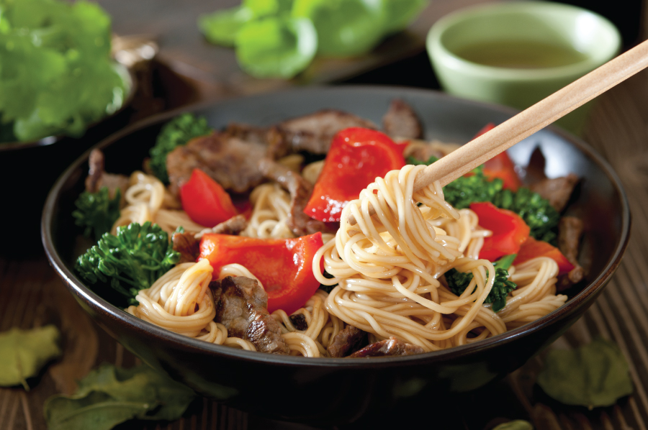
Pre-Endurance Event Meal
Light meal, 1 to 4 hours prior to event.
Primarily of carbohydrate (top off glycogen stores).
Moderate fat and fiber
Avoid fatty, fried foods.
High-quality protein.
Blended or liquid meal
recommended for meals
eaten within 1 hour prior.
Pre-event meals may require a higher proportion of grains than suggested by MyPlate to boost carbohydrate content. Starchy vegetables and grain-based snacks.
cobraphotography/ Shutterstock
Notes:
What do endurance athletes use? Endurance is long-distance, so these people need to focus on those carbs to prevent fatigue. Before an event, they're going to try and stock up on some carbs.
A light meal before the event should supply some carbohydrates.
Within the realm of carbohydrates, we have simple, we have complex, and we have fiber.
What kind is best? Simple or complex carbohydrates are good because those are going to supply some energy. We want to stay away from fiber.
Fiber can slow down your digestion and cause GI distress. You don't want to have a bellyache while you're exercising. Even though we encourage fiber, right before your event is not the time to eat a bunch of bran. You want to get in easily digestible carbohydrates like simple sugars and starch. That’s a complex carbohydrate, but it's pretty quickly digested and absorbed. The starches and sugars are best. It should be low in fat as well because fat is slow to digest and absorb. You don't want to have that meal hanging around in your stomach while you're exercising. That might cause GI distress. It’s going to take a while for that to be digested. It’s not going to be available for you during the race.
Moderate protein is fine, but we don't need to go overboard on the protein. We're going to save that for after our workout.
For fat, just the same thing. It's slowly digested. That would just kind of hang out in the stomach and make a person feel uncomfortable while they're working out. You're really not going to be able to get the energy from that fat for several hours. Eat a low-fat meal before the race. You can have a little protein, but it's not going to fuel you during the race. The protein is best for after your race. We're going to focus on carbs. Again, we have this question of solid or liquid? If you have a few hours before the event – like you got up at five and your race isn’t until nine – you can have a solid meal. The closer you get to that event, then you’ll want to do a blended or liquid meal. It moves out of your stomach pretty quickly.

Slide 74
Table 10-7: High-Carbohydrate Pre-Event Meals
Breakfast
Cheerios®, ¾ cup Reduced-fat milk, 1 cup Blueberry muffin, 1 Orange juice, 4 ounces or Low-fat fruit yogurt, 1 cup Plain bagel, ½ Apple juice, 4 ounces Peanut butter (for bagel), 1 tbsp | 784 kcal 110 grams (59%) carbohydrate 541 kcal 92 grams (68%) carbohydrate
Lunch or Dinner
Broiled chicken, 3 ounces Rice, 1½ cups Steamed zucchini, 1 cup Low-fat chocolate milk, 1 cup Jello®, ½ cup or Spaghetti noodles, 2 cups Spaghetti sauce, 1 cup Reduced-fat milk, 1½ cups Green beans, 1 cup | 709 kcal 116 grams (64%) carbohydrate 709 kcal 132 grams (66%) carbohydrate
Notes:
Even if an endurance athlete chooses not to practice a strict carbohydrate-loading regimen, a meal should be eaten 1 to 4 hours before an endurance event to:
top off muscle and liver glycogen stores,
prevent hunger during the event, and
provide extra fluid.
A pre-event meal should consist primarily of carbohydrate, contain moderate fat or fiber, and include high-quality protein.
Some examples are shown here in Table 10-7.

Slide 75
Fat Adaptation
Becoming popular among endurance athletes.
Only 2,000 to 3,000 kcal available from muscle glycogen.
Limitless supply of energy from triglycerides stored in muscle and adipose tissue.
Can supply about half the energy during endurance events.
High-fat training eating plan:
25% of calories from carbohydrate.
60% to 70% of calories from fat.
Cells adapt to use fat for fuel.
Research mixed on the best approach.
Notes:
Some athletes are trying something called fat adaptation.
It goes along with the whole ketogenic diet we've been talking about.
By limiting the amount of carbohydrates in your diet, you are training your cells to use fat more efficiently.
Some athletes are trying this out, where during training, they would limit carbs and eat mostly fat, like 60 to 70 percent of their calories from fat.
Then they would train their muscles to be able to use fat more efficiently.
The research on fat adaptation is mixed.
Some studies show that this could be an effective tool.
Some athletes are able to do this.
Maybe it’s best to combine this with carbohydrates.
You train in this fat adaptation state, so you're training your muscles to be able to use fat more efficiently.
Then during the race, you supply those carbs, so you can have that quick burst of energy at the end.
Research on this is mixed and ongoing, but it’s something to keep an eye on.
Most sports nutrition experts will tell you to use carbohydrates for training and endurance activities.

Slide 76
Replenish Fuel During the Event
For events longer than 60 minutes.
Carbohydrate consumption improves performance.
Consume 30 to 60 grams of carbohydrate per hour.
Use different sources (glucose, fructose, and maltodextrin) with different rates of absorption.
Protein products containing amino acids may provide benefit.
Notes:
We have so many different sports nutrition products. A lot of folks don't worry about carbohydrates before events. They just think, well, I can replenish my carbohydrate stores in the middle of my race.
During events that are endurance races and 60 minutes or longer, consuming some simple sugars during that race helps prevent fatigue. It's going to keep glucose levels steady, and you'll have some carbohydrates to burn. This will help when you really want to put on the fire at the end of that race. The number here is 30 to 60 grams of carbohydrates per hour. That's like a handful of jellybeans or one energy gel pack, maybe two for a long-distance race.
Those are some good strategies. It doesn't have to be an expensive brand-name product. It can just be jelly beans or something simple and inexpensive. For protein, some people would say that an energy drink with protein or amino acids might help. Really, the best thing is to focus on getting carbohydrates. Fat is not recommended during exercise. That's going to cause GI distress, and that energy is not going to be available for a while.
Sports drinks would provide carbohydrates. Sometimes they provide several different types of simple carbohydrates. They’re taking advantage of the multiple different ways you can absorb carbohydrates, to really get that into your blood.

Slide 77
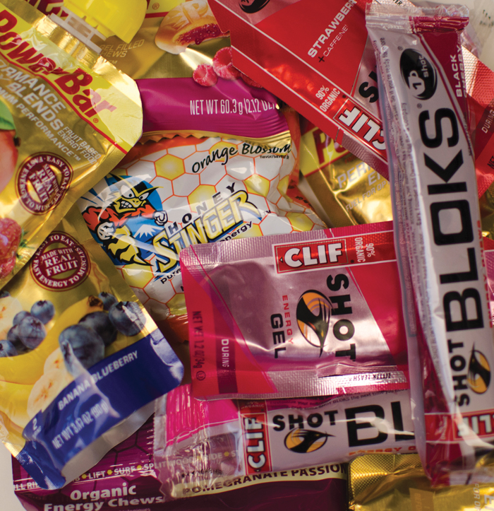
Gels, Bars, and Chews
Provide additional fuel.
Should be taken with fluids.
Expensive source of nutrients.
  Toxicities possible with overuse.
Ideal bars for endurance athletes contain:
  40 grams of carbohydrate
  10 grams of protein
  4 grams of fat
  5 grams of fiber
  Fortified with vitamins and minerals
Mark Dierker/McGraw-Hill
Notes:
There are a lot of sports nutrition products that supply glucose and other forms of carbohydrates that are quickly absorbed.
It doesn't have to be a fancy sports nutrition product, it just needs to be something that can replenish glucose as you go.
Energy bars and energy gels are good.
We can eat them, we can carry them with us, and we can use them at a rest stop during a long race.
We don’t want to go to high fiber with energy bars.
You could carry gels, or you can have jellybeans.
If you're going to use gels or bars, those are not supplying the fluid you need during your race.
You have to drink water in addition to that.
Whereas, the sports drink meets your needs for carbohydrates, fluid, and electrolytes.

Slide 78
After Physical Activity: Replenish Glycogen and Fluid
Glycogen synthesis greatest immediately after exercise.
Muscles are insulin-sensitive at this point.
To rapidly restore glycogen stores:
Consume 1.0 to 1.2 grams of carbohydrate per kilogram body weight within 30 minutes after endurance physical activity.
Repeat process every 2 hours for the next 4 to 6 hours.
Foods such as fruit, fruit juice, bread, or a sports drink contribute to rapid restoration of glycogen stores.
Add 0.25 to 0.3 gram of high-quality protein per kilogram body weight to stimulate glucose uptake and repairing damaged muscle tissue.
Notes:
After a workout is when we're going to start to put in that protein. After you’ve worked out, you’ve broken down your muscle tissue a little bit. Now, you're going to rebuild. Your body has natural mechanisms to repair itself right after that race. During those first few hours after your workout, your muscles are insulin sensitive. Exercise improves insulin sensitivity. That means your muscle cells will be primed to take up carbohydrates from your blood to replenish your glycogen. Insulin doesn’t only cause you to take up glucose, it also helps you take up fat and protein.
Right after your event, you want to supply carbohydrates to replenish your glycogen, which you've depleted. This is especially true if you're going to work out again the next day or that same day. You want to put in some protein to provide amino acids as building blocks for your muscles to get repaired.

Slide 79
Strength and Power Athletes: Strategies to Enhance Muscle Gain
Calories:
  Need to be higher.
  Due to additional lean muscle mass.
Fuels:
Phosphocreatine and carbohydrates
  For brief bursts of activity, little protein.
Protein:
  Most needed early, in building phase.
  Reduced need in maintenance.
  Some extra protein during recovery.
  Consuming more protein than recommended offers no advantage.
Notes:
Here are a few other important tips for folks that are not doing endurance activity, but more of the strength and power activities. Muscle strength is the amount of weight you can lift from one rep. Muscle endurance is being able to do many reps over time. Both of those are important, but this is specifically about strength and muscular power. Power sports combine strength and speed. You need to have a big burst of energy to do a power move like jumping or lifting something really heavy. Some people would say football’s a power sport because a lot of the time you're waiting for the next thing to happen, but then all of a sudden, you have to be strong and fast.

Slide 80
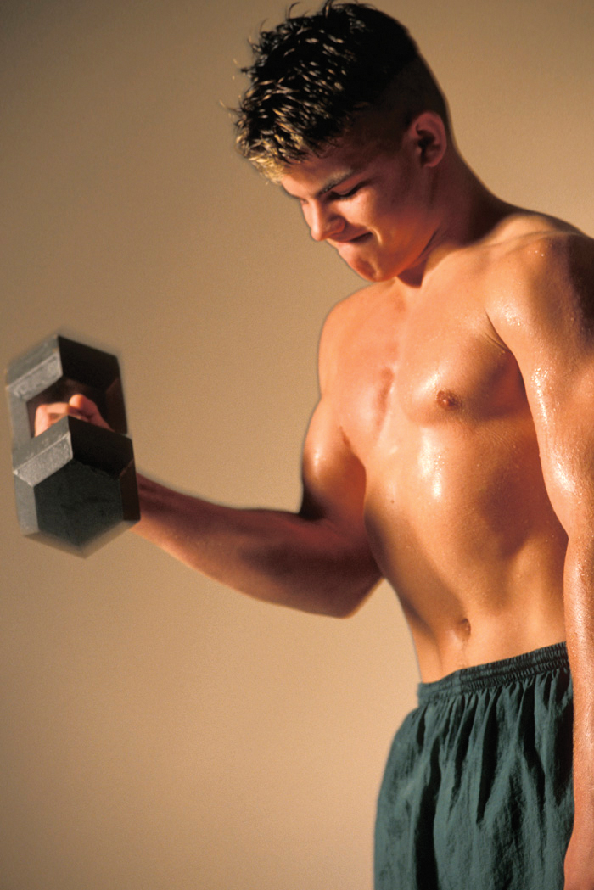
Needs Before and During Strength and Power Training
Focus: calories, carbohydrates, and fluids.
Adequate hydration:
  Detected through urine color.
  Water or sports drinks sufficient.
Adequate carbohydrate ingestion, immediately before/after exercise:
    4 to 7 grams per kilogram body weight.
Creatine supplements:
  An option in power sports.
  Fat intake 20% to 35% total calories.
Ingram Publishing
Notes:
How do you eat for that kind of activity? It’s the same kind of stuff. You want to make sure to stay hydrated. Not having enough carbohydrates and fluid are the two things that really lead to fatigue during exercise. We need carbs and fluids.

Slide 81
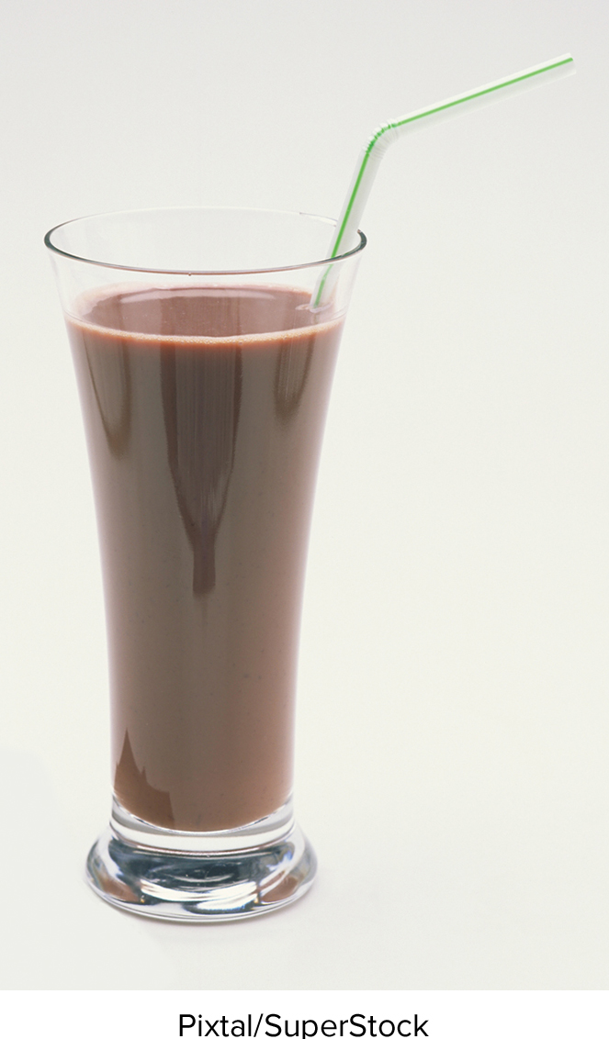
Needs After Strength and Power Activities
Consuming carbohydrates and protein promotes recovery.
Carbohydrates: 1.2 to 1.5 grams per kilogram of body weight.
Protein: Consume 15 to 25 grams of high-quality protein 1 to 2 hours after exercise.
Requires 3:1 ratio of carbohydrate to high-quality protein.
This 2-cup serving of low-fat chocolate milk is a go-to recovery drink with 52 grams of carbohydrate and 16 grams of protein.
Notes:
Right after your event, you want to supply carbohydrates to replenish your glycogen, which you've depleted. This is especially true if you're going to work out again soon. You want to put in some protein to provide amino acids as building blocks for your muscles to get repaired. The optimal ratio is going to be 3 to 1 or 4 to 1 grams of carbohydrates to protein. It’s basically what you would consume in a regular meal. For muscle strength and power moves, the emphasis is placed on protein during the recovery phase. If you're going to build muscle, you need extra amino acids as raw materials to build those muscles. Really focus on protein in the recovery meal. We talked about the protein needs of athletes, they are probably higher than the RDA of 0.8 grams per kilogram. Two grams per kilogram is really the max that you can use. For somebody in the early phase of muscle training that needs to put on muscle mass, two grams per kilogram is about as much as you can utilize. Most people probably don't need that much, but a lot of strength athletes are eating more than that. It's probably just being burned as fuel or stored as fat. Another point here is to include at least 20 grams of protein in post-workout meals. That's enough to stimulate muscle protein synthesis. Most people are getting this much in a meal. It's pretty typical to get 30 to 40 grams in a meal. You don’t want to be excessive, but make sure to get a good dose of at least 20 grams of protein. Twenty grams is a 3 ounce portion of meat, or a cup of tuna. That's not a huge dose, but it's making sure to stimulate muscle protein synthesis. Folks are really into whey protein a protein you find in milk and other foods. Leucine is one of the branched-chain amino acids in there that seems to stimulate muscle protein synthesis. Why do we have chocolate milk here? That chocolate flavor tastes good and adds sugar for the carbohydrates you need after a race. It doesn’t have to be chocolate because milk has carbohydrates but chocolate flavor will make you want to drink it. It has that optimal ratio of 3 to 1 or 4 to 1 grams of carbohydrate to protein. It provides fluid and electrolytes. It’s a great recovery tool. The amount of sugar added to chocolate milk is not huge. Within a few hours after your workout, get your first dose of carbs and protein to refuel your muscle glycogen and repair your tissues. Then repeat that again in about two hours. That's going to help to get your muscles in good shape for your next workout.

Slide 82
NEWSWORTHY NUTRITION: Branched-chain amino acids impact health and lifespan in mice
Branched-chain amino acids (BCAAs) leucine, isoleucine, and valine have muscle-building benefits, but in excess may reduce lifespan, negatively impact mood, and lead to weight gain
INTRODUCTION: Elevated BCAAs are associated with obesity and insulin resistance.
OBJECTIVE: To evaluate the long-term effects of BCAA exposure on appetite, weight, mood, and lifespan.
METHODS: Mice were fed dietary BCAAs in amounts of 200%, 50%, or 20% of the typical intakes throughout their life.
RESULTS: Mice who were fed the highest amount of BCAAs increased their blood BCAA levels, which resulted in obesity and a shortened lifespan.
CONCLUSION: Diets high in protein and low in carbohydrates had detrimental effects for health of mice in mid to late life, and also led to a shortened lifespan. Athletes should vary protein sources in order to get a variety of essential amino acids through a healthy and balanced diet rich in fiber, vitamins, and minerals.
Source: Solon-Biet SM and others: Nature Metabolism 1(5):532, 2019.

Slide 83
Periodization
Training technique used by power athletes.
  Physical stresses on body change throughout the year.
Early in training season:
  Athletes work on building aerobic endurance.
After gains in aerobic capacity achieved:
  Focus shifts to building strength, power, and sport-specific skills.
During competitive season:
  Daily workouts are scaled back, but activity is intense and of long duration on game days.
In the off-season:
  Athletes work out to stay in shape, but volume is lower than it was in the season.
Notes:
Many power athletes utilize a training technique called periodization, in which physical stresses on the body change throughout the year.
The stages of this periodization are listed here.

Slide 84
Table 10-9: Sample Recovery Meals
Option 1:
491 kcal,
69 grams carbohydrate,
31 grams protein, 10 grams fat.
Bagel, 1 regular
Deli turkey, 1 ounce
Swiss cheese, 1 ounce
Low-fat milk, 1 cup
Option 2:
571 kcal,
81 grams carbohydrate,
38 grams protein, 12 grams fat.
Low-fat Greek yogurt, 16 ounces
Banana, 1 medium
Option 3: (plant-based)
289 kcal,
52 grams carbohydrate,
28 grams protein,
1.5 grams fat.
Chickpeas, ½ cup
Quinoa, ½ cup
Tomatoes, 2/3 cup canned
Notes:
Overall, recovery from resistance training requires a combination (3:1 ratio) of car-bohydrates and high-quality protein.
For a 154-pound (70-kilogram) athlete, this cor-esponds to about 70 grams of carbohydrate and 25 grams of protein in each 2-hour interval.
Table 10-9 provides several options for recovery meals for athletes.

Slide 85
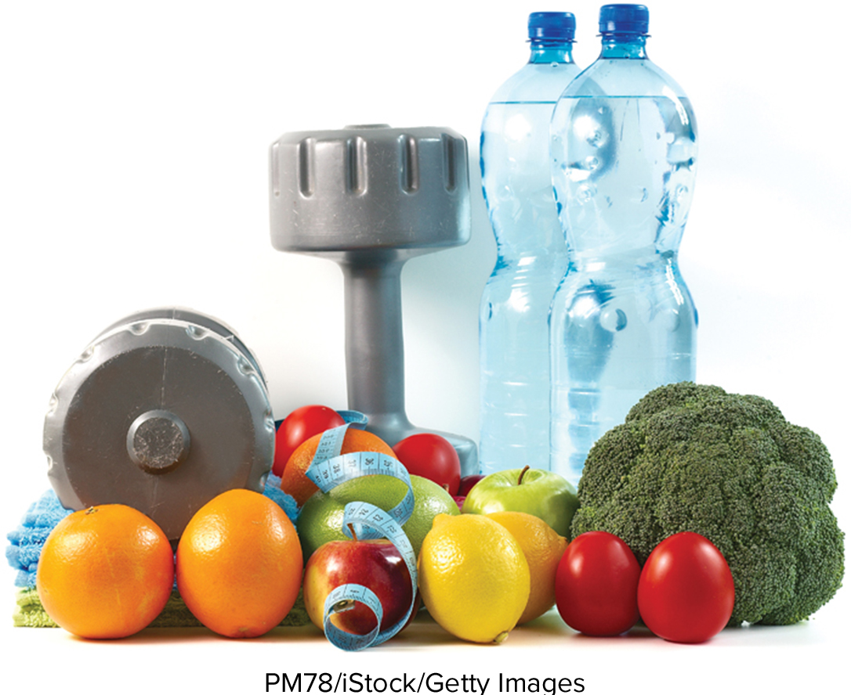
ASK the RDN: Boosting Your Metabolism
To speed up your metabolism:
Get plenty of sleep: 7 to 9 hours.
Start your day with breakfast
Eat smaller frequent meals
Eat more protein-rich foods: more calories are burned digesting protein compared to fat or carbohydrates.
Exercise to stimulate and build muscle: muscle is more metabolically active than fat.
Drink plenty of water: mild dehydration will slow your metabolism. Drinking caffeine- containing beverages drinks may cause a short-term rise in your metabolic rate.
Notes:
This response is to: Dear RDN: I am concerned that my “slow metabolism” may be making it difficult to maintain a healthy weight. Are there things I can do that will increase my metabolism and help prevent my weight from creeping up?
Metabolism is an important component of weight control. Good news! You can speed up your metabolism, by incorporating the following tips into your lifestyle.
Get a good night’s sleep (7 to 9 hours). Sleep deprivation leads slows metabolic rate because of negative effects on insulin and stress hormone levels, appetite, and ability to metabolize sugar.
Eating a healthy breakfast jump-starts your metabolism, breaking it out of its fasting metabolic state. Research shows that breakfast eaters are more likely to have a healthy BMI (under 25).
Eating more often and snacking, a small meal or snack every 3 to 4 hours, can actually help boost your metabolism. As you go through your day, eating will help you burn more calories. In contrast, eating large meals, skipping meals, following very-low-calorie diets, and fasting often decrease overall calorie intake but at the expense of a slower metabolism.
Eating more protein-rich foods will boost metabolism because more calories are burned digesting protein compared to fat or carbohydrates.
Muscle is more metabolically active than fat; building muscle can cause a long-term increase in your metabolism. Strength training leads to muscle growth and raises your energy expenditure for the day. Aerobic exercise increases your metabolism, not only during a workout but for a few hours afterward. Including high-intensity interval training (HIIT) will result in a greater, more sustained rise in resting metabolic rate compared to low- or moderate-intensity workouts.
Stay hydrated. Even mild dehydration will slow your metabolism. Individuals who drink more water (eight or more glasses a day) burn more calories than those who drink less. Drinking a glass of water before every meal and snack will help you stay hydrated. Drinking caffeine- containing beverages may cause a short-term rise in your metabolic rate. However, “energy drinks” should not be part of your metabolism-boosting program

Slide 86
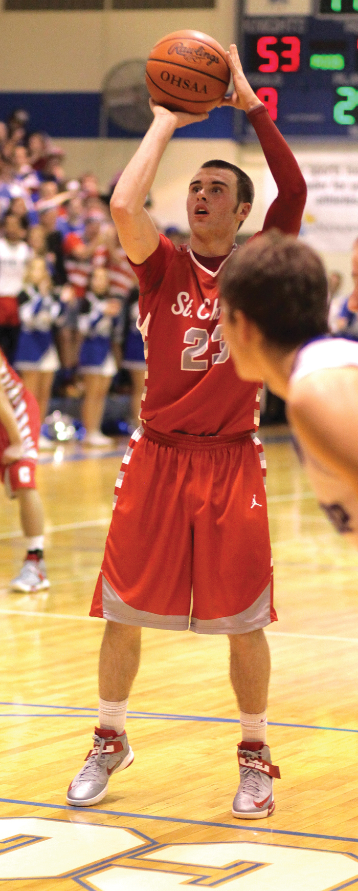
Nutrition Challenges for Athletes
Athletes are subject to same nutritional challenges as the general public:
Overreliance on convenience foods.
Abundance of nutrition misinformation.
Temptations to eat out of boredom or for emotional comfort.
In addition, they must adapt to seasonal demands of their sport and maintain exhausting training and travel schedules.
©George Postalakis
Notes:
Athletes are subject to all the same nutritional challenges as the general public: overreliance on convenience foods, abundance of nutrition misinformation, temptations to eat out of boredom or for emotional comfort.
Furthermore, they must adapt to the seasonal demands of their sport and maintain exhausting training and travel schedules.

Slide 87
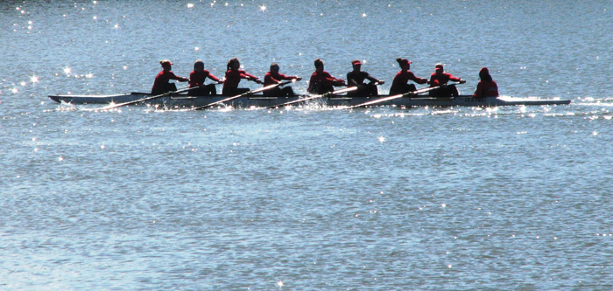
Section 10.6: Nutrition and Your Health: Ergogenic Aids and Athletic Performance
Colleen Spees
Name two permissible and two non permissible ergogenic aids.
What are some risks associated with commonly used ergogenic aids?

Slide 88
Ergogenic Aids
Ergogenic aid:
  A mechanical, nutritional, psychological, pharmacological, or physiological substance or treatment intended to directly improve exercise performance.
Ergogenic aids include:
  Sufficient water
  Electrolytes
  Adequate carbohydrates
  Balanced and varied dietary pattern consistent with MyPlate.
Notes:
Let's talk about ergogenic aids. Ergogenic means work-producing.
There are a lot of folks out there trying to improve themselves with sports nutrition; they are looking for a competitive edge.
They want to do whatever they can to make themselves a few seconds faster or able to lift a few more pounds. Athletes are pretty susceptible to marketing.
They’re looking in muscle building magazines and watching things on social media about the products that you could use to improve your sports performance.
The best two ergogenic aids are adequate fluid and adequate carbohydrate because you need it to fuel your cells and transport that fuel to your cells from your blood. You also need it to be able to remove the waste.
That's the fluid aspect of it. Those two things, lack of fluid and lack of carbohydrate, are what’s going to lead to fatigue the majority of the time. Those are your best two ergogenic aids.

Slide 89
Ergogenic Aids and Athletic Performance
Protein and amino acid supplements not among aids.
  Athletes can easily meet protein needs from foods.
Dietary supplements should only be used to meet dietary shortcoming.
U.S. sports nutrition supplement market exceeds $11 billion.
Be skeptical until scientifically validated.
Some contain substances that are banned.
No “magic bullet” to improve your training routine.
Notes:
We need to be careful because we know supplements are not well regulated.
They could be contaminated with all kinds of junk. People that are athletes have to comply with some specific rules about what kinds of substances can be in their system.
There have been cases where someone has been taking a sports nutrition supplement, and it was contaminated with something that was off-limits, then they got disqualified.
We have to be careful about that kind of stuff. Coaches aren't allowed to provide a lot of these sports nutrition products for those reasons. If you want to know where to find information about sports nutrition products, there's a supplement database from the Office of Dietary Supplements – or ODS – that you can go on. If you have a question about a sports supplement and you’re not sure what it does, you want to know if it's effective, or if it's safe, you can get on there and check it out. That's a good source of information for you on any kind of supplements, including sports supplements.

Slide 90
Table 10-10: Potentially Useful Ergogenic Aids
Substance/Practice | Purported Use
Beta-alanine | Increase muscle carnosine, a protein that neutralizes acidic compounds that contribute to muscle fatigue during high-intensity exercise
Caffeine | Increase vigilance and mental alertness; improve endurance performance
Creatine | Increase lean mass; improve short-term intense exercise performance; aid muscle recovery
Sodium bicarbonate (baking soda) | Neutralize acidic compounds that contribute to muscle fatigue
Tart Cherry | Reduced stress on the body from heavy bouts of training
Notes:
There are lots of aids out there. Some are shown to have benefits. Some things might be useful, but they still need more research to be able to tell us that they're good. Also, a lot of things are really dangerous and not good at all. I'm going to focus on a few things that are known to be good sports nutrition products or ergogenic aids. These are some that are proven to work.
Beetroot juice is something kind of new. Beetroot juice has something called nitrates, and those help to improve blood flow. That could be helpful for some athletes.
Beta-alanine and sodium bicarbonate do something similar. Beta-alanine is a type of protein, and then sodium bicarbonate is a fancy word for baking soda. Both of these things counter the acid build-up that occurs in your muscles. When you work out really hard and fast, it’s anaerobic, which means no oxygen. In that first step of glucose breakdown, you can get some ATP really quickly. If you try to do that too long, it leads to acid byproducts and contributes to fatigue in your muscles. You know that burning feeling? These two products, beta-alanine, and sodium bicarbonate, counter that build-up of acid. They can help people who are doing power sports like lifting or sprinting to work a little longer and harder. One thing to think about is sodium bicarbonate is super inexpensive. All you do is mix some baking soda in some water, but It can cause gastrointestinal upset. It's something you wouldn’t want to try for the first time during an event. You should try it out during training.
Caffeine can be helpful, especially during an endurance event, to decrease your perception of fatigue. A while ago, people had this hypothesis that caffeine helped burn fat, but research does not support that. The best thing caffeine does is help you not feel tired. It helps you stay alert and vigilant with your activity.
Then creatine is also helpful for those power sports, like sprinting, because that helps you resupply ATP quickly, like within the first couple of minutes of activity.

Slide 91
Table 10-11: Dangerous, Banned, or Illegal Substances and Practices
Substance/Practices | Purported Use | Risks
Anabolic steroids (such as testosterone) | Increase muscle mass and strength | Liver cysts; increased risk of cardiovascular disease, hypertension, and reproductive dysfunction; depression, sleep disturbances, mood swings
Blood doping | Enhances aerobic capacity by increasing red blood cells | Blood thickening that strains the heart
Peptide hormones and analogues (such as growth hormone) | Increases muscle mass and fat metabolism | Uncontrolled growth of the heart and other internal organs; death
Stimulants (such as, caffeine, ephedrine) | Increases muscle strength and power, promotes mental alertness, weight loss | Heart palpitations, anxiety, and death
Notes:
Dietary supplements rumored to enhance athletic performance require careful evaluation and monitoring.
Overall, there is little scientific evidence to support the efficacy of many substances that are touted as performance-enhancing aids.
Of these, many are useless, and some are dangerous enough to promote organ damage.
Some of the dangerous or illegal substances and practices are listed here in Table 10-11.
The liver and kidneys are particularly susceptible to damage because these organs help detoxify harmful compounds.

Slide 92
End of Main Content
© 2022 McGraw Hill, LLC. All rights reserved. Authorized only for instructor use in the classroom.
No reproduction or further distribution permitted without the prior written consent of McGraw Hill, LLC.

Slide 93
Accessibility Content: Text Alternatives for Images

Slide 94
Figure 10-1: Benefits of Physical Activity - Text Alternative
Return to parent-slide containing images.
Gains: Bone health, physical functioning, lean body mass, sleep, quality of life, and cognitive function. Decreases: All-cause mortality, fall-related injuries, weight gain, depression, anxiety, dementia, cancers, type 2 diabetes, dyslipidemia, hypertension, and cardiovascular incidence.
Return to parent-slide containing images.

Slide 95
Figure 10-2: Heart Rate Training Chart - Text Alternative
Return to parent-slide containing images.
The heart rates and M H R are as follows: 180 to 200: 90 percent to 100 percent M H R is maximal effort zone. 160 to 180: 80 percent to 90 percent M H R is anaerobic zone. 140 to 160: 70 percent to 80 percent M H R is aerobic zone. 120 to 140: 60 percent to 70 percent M H R is weight-management zone. 100 to 120: 50 percent to 60 percent M H R is heart health zone.
Return to parent-slide containing images.

Slide 96
Figure 10-3: Rating of Perceived Exertion Scale - Text Alternative
Return to parent-slide containing images.
The points with inferences: 0 is at rest; 1 is very easy; 2 is somewhat easy; 3 is moderate; 4 is somewhat hard; 5 and 6 are hard, 7 to 9 are very hard; 10 is very, very hard.
Return to parent-slide containing images.

Slide 97
Figure 10-4: Sample Fitness Plan - Text Alternative
Return to parent-slide containing images.
Monday: Spinning class (45 min), Stretching routine (20 min). Tuesday: Walking (30 min), Weight machines (30 min). Wednesday: Spinning class (45 min), Stretching routine (20 min). Thursday: Walking (30 min), Weight machines (30 min). Friday: Yoga (30 min), Saturday: Trail hiking (60 min). Sunday: Rest.
Return to parent-slide containing images.

Slide 98
Figure 10-5: Food Energy Is Stored in ATP - Text Alternative
Return to parent-slide containing images.
A T P has adenosine bonded to 3 phosphate groups that are linked by high-energy bonds. A T P breaks to give A D P (energy to work) and phosphate group. A D P (energy from food) combines with phosphate group to form A T P.
Return to parent-slide containing images.

Slide 99
Figure 10-7: ATP Yield From Glucose - Text Alternative
Return to parent-slide containing images.
Aerobic and anaerobic breakdown of glucose (6-carbon) to 2 pyruvate (3-carbon) and 2 A T P. 2-Pyruvate undergoes anaerobic respiration to give lactate (3-carbon). 2-Pyruvate undergoes aerobic respiration to give 28 to 30 A T P, 6 C O 2, and 6 H 2 O.
Return to parent-slide containing images.

Slide 100
Figure 10-8: ATP Formation from Carbohydrate, Fat, and Protein - Text Alternative
Return to parent-slide containing images.
Dietary protein: Protein used to form body cells; amino acids in the bloodstream. Dietary carbohydrate: Blood glucose; glucose stored in glycogen. Dietary fat: Fatty acids and triglycerides in the bloodstream; fat stored in body cells. Lactate through anaerobic metabolism in cytoplasm and fatty acids enter the citric acid cycle through acetyl Co A. Amino acids release N H 3 and enter the citric acid cycle. Glucose releases A T P. Aerobic metabolism occurs in mitochondria. Electron transport chain releases A T P, C O 2 and H 2 O.
Return to parent-slide containing images.

Slide 101
Figure 10-11: Relative Energy Deficiency in Sport - Text Alternative
Return to parent-slide containing images.
Low Energy Availability has the following effects: Cardiovascular system: Irregular heart rhythm, Fainting, Anemia. Endocrine system: Impaired growth, Decreased B M R. Musculoskeletal system: Low bone mass, Muscle injuries, Decreased strength, Decreased endurance. Reproductive system: Amenorrhea, Infertility. Immune system: Frequent illness. Digestive system: Esophagitis, Ulcers, Constipation. Nervous system: Decreased coordination, Irritability, Depression.
Return to parent-slide containing images.

Slide 102
Figure 10-12: Sports Drinks - Text Alternative
Return to parent-slide containing images.
The nutrition facts are as follows: 4 servings per container, Serving size 8 f l o z (240 m l). Amount per serving: 50 calories. Percent Daily Value: Total Fat 0 g 0 percent. Sodium 110 m g 5 percent, Potassium 30 m g 1 percent, Total Carbohydrates 14 g 5 percent, Total Sugars 14 g Includes 14 g Added Sugar 28 percent. Protein 0 g. Not a significant source of fat, cholesterol, dietary fiber, protein, vitamin D, calcium, iron, and potassium.
Return to parent-slide containing images.

